Slide 1
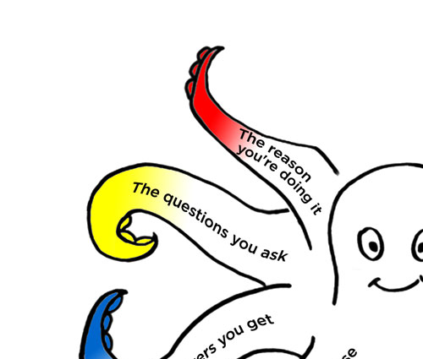
Surveys that work
Session 3 of 3
An introduction to
the Survey Octopus
and Total Survey Error
Caroline Jarrett
@cjforms
#surveysthatwork2022

Slide 2
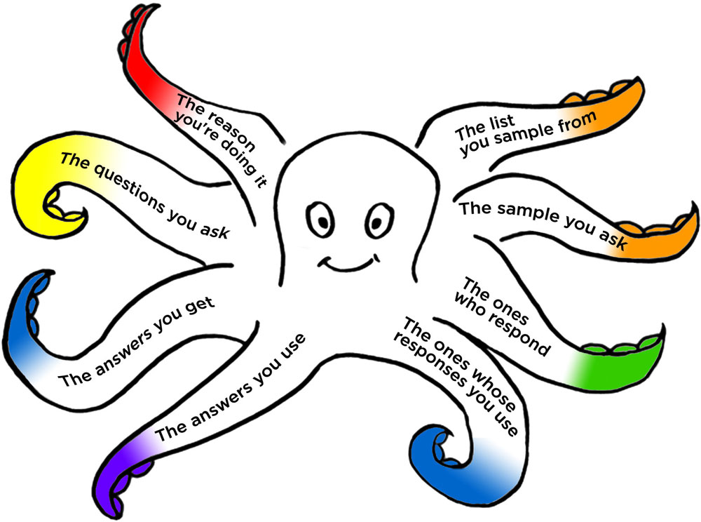
Let’s have a quick reminder of the Survey Octopus
Getting answers
Working with answers
Notes:
The octopus again; we've looked at 6 of the 8 tentacles.

Slide 3
Here are the 7 steps as a linear process
  Goals
  Sample
  Questions
  Questionnaire
  Fieldwork
  Responses
  Reports
  Establish your goals for the survey
  Decide who to ask and how many
  Test the questions
  Build the questionnaire
  Run the survey from invitation to follow-up
  Clean and analyse the data
  Present the results
  Questions you need answers to
  People you will invite to answer
  Questions people can answer
  Questions people can interact with
  People who actually answer
  Answers
  Decisions

Slide 4
Today we work with answers
  Goals
  Sample
  Questions
  Questionnaire
  Fieldwork
  Responses
  Reports
  Establish your goals for the survey
  Decide who to ask and how many
  Test the questions
  Build the questionnaire
  Run the survey from invitation to follow-up
  Clean and analyse the data
  Present the results
Monday
Yesterday
Today

Slide 5
Cleaning data
  Responses

Slide 6
I use these terms (mostly)
  Responses
A response the entire set of answers from one person
An answer the answer to a specific question
Adjustment error happens when you make less than perfect choices about whose responses to include
Processing error happens when you make less than perfect choices about which answers to include

Slide 7
Cleaning data is about deciding what to use
  Responses
Processing error
Adjustment error

Slide 8
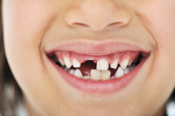
Clean your data
  Responses
Read the answers to make sure that
they make sense compared to the questions
Look for gaps and missing entries
Remove any (unintended) duplicate responses
Image credit: Shutterstock
Adapted from Boslaugh, S. and P. A. Watters (2008) Statistics in a nutshell O’Reilly

Slide 9

Datasets always need some cleaning
  Responses
Examples of problems within answers
  Leftover test data that has not been removed
  Curly quote ’ turned into ‰Ûªs
  “Not safe for work” language
  Names and email addresses of individuals in open box answers
  Numeric answers outside of plausible ranges
Examples of problems with whole responses
  Incomplete responses where people broke off
  Duplicate or multiple responses from the same person
  Responses clearly from outside the hoped-for group of users
Image credit: North Korean flag, http://commons.wikimedia.org/wiki/File:Flag_of_North_Korea.svg

Slide 10

Think about – and maybe redact – personal data
  Responses
Names, addresses, and IP addresses
Rarer responses that create potential anonymity problems
  Ethnic origins that are uncommon in your area
  Countries that are infrequent in your dataset
  Areas with smaller populations such as Alaska or Hawaii
  Genders that are less often seen in your dataset
  Unusual occupations
    “alpaca breeder” outside the Andes
    “forms specialist” is likely to be me
Photo by Ava W. on Unsplash

Slide 11
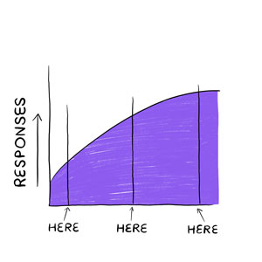
Start analysing when you have any responses
  Responses

Slide 12
Answers can also reveal problems with questions
  Responses
Measurement error

Slide 13
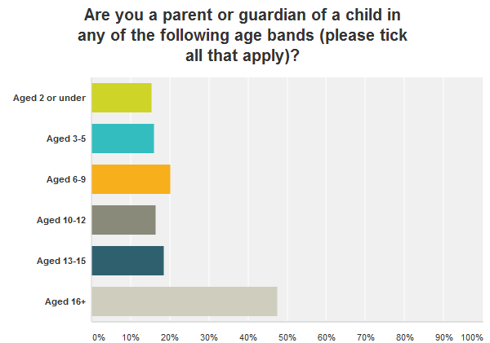
  Responses

Slide 14

Look after your data
  Responses
Data analysis can take a long time;
you won’t want to repeat it
  Make copies of your data, especially before any drastic change
  ‘Undo’ doesn’t always work on large files
Make notes of what you did
  It helps if you have to defend your conclusions
  It’s hard to remember the details a year later
Image credit: Shutterstock

Slide 15
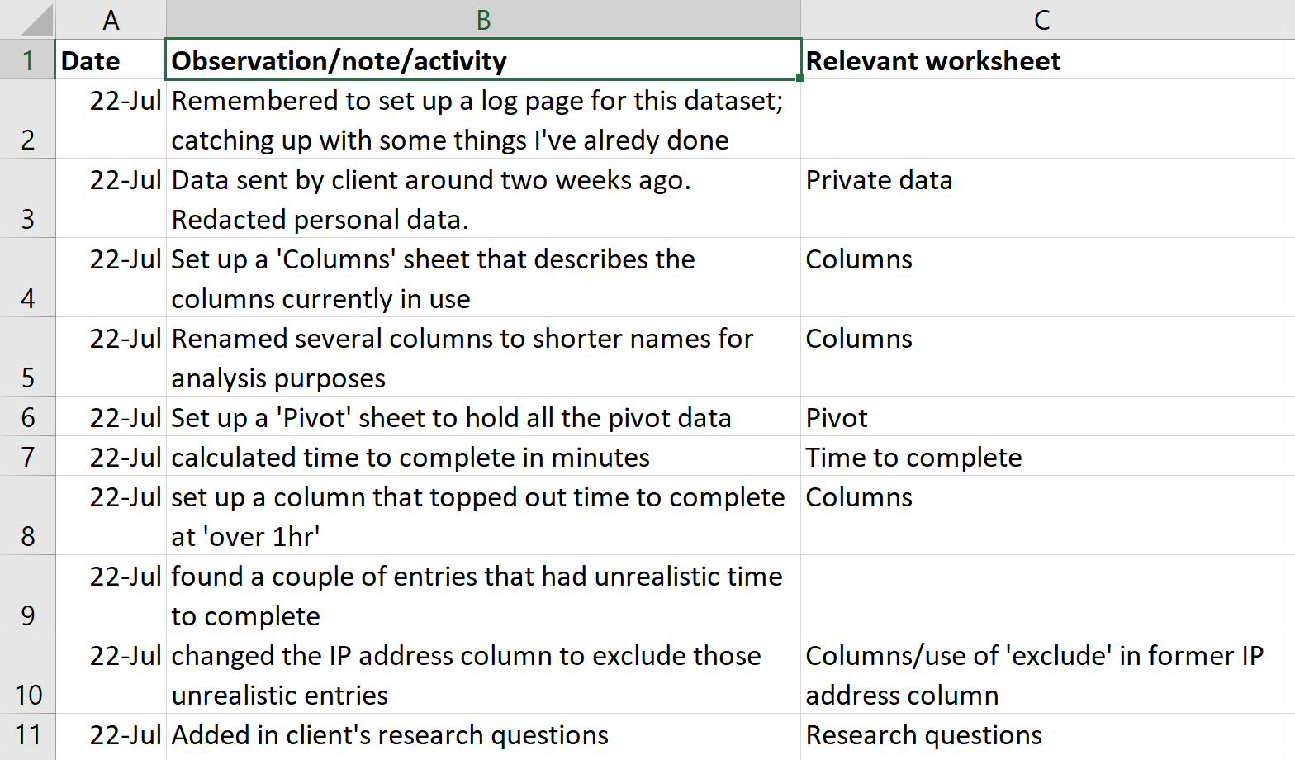
My logs have dates, activity, worksheet
  Responses

Slide 16
Dealing with missing data
  Responses

Slide 17
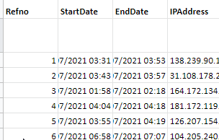
Here is a dataset
  Responses
It’s the first 30 responses to a survey
I’ve already redacted all personal information
I also added a column ‘Refno’ to help keep track of each entry

Slide 18
Have a go at data cleaning
  Responses
You’re going to try the next stage of data cleaning
Your next decisions are about responses
  Which columns would you remove? Why?
  Would you rename any columns? To what?
  Which entries would you remove? Why?
Someone in each group be ready to tell us all your choices
10 minutes

Slide 19

Decide what to do when people have skipped questions or dropped out
  Responses
Remove the whole of that person’s response
Use the partial responses, and accept that your number of responses is lower for some questions
Calculate an “imputed value”
  Include a flag showing that the value is calculated
  Estimate the most likely value using the other data
Photo by Artur Tumasjan on Unsplash

Slide 20
You can interpret data well – or poorly
  Responses
Processing error

Slide 21
Dealing with numeric answers
  Responses

Slide 22
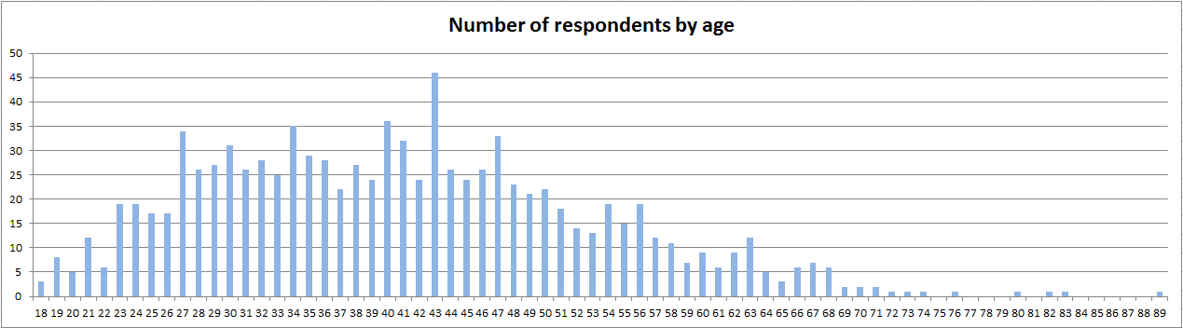
Explore your data and ask questions
  Responses

Slide 23
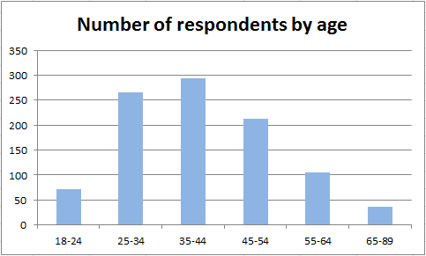
Explore your data and ask questions
  Responses

Slide 24
Use descriptive statistics to explore numerical data
  Responses
Useful for thinking about the data
  Range (lowest to highest) 18 to 89
  Mode (most common answer) 43
  Median (middle answer) 39

Slide 25
Use descriptive statistics to explore numerical data
  Responses
Useful for thinking about the data
  Range (lowest to highest)
  Mode (most common answer)
  Median (middle answer)
Most seen for statistics
  Mean (arithmetic average)
  Standard deviation (spread of answers)

Slide 26
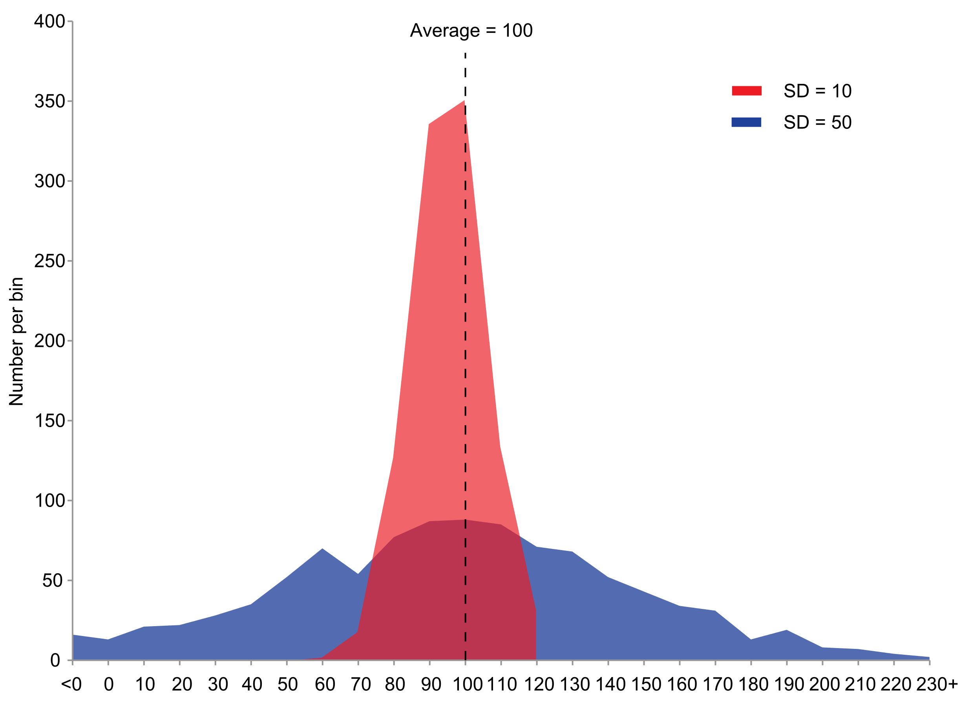
Standard deviations (SD) show spread
  Responses
By JRBrown - Own work, Public Domain, https://commons.wikimedia.org/w/index.php?curid=10777712

Slide 27
Justin Matejka has a set of images, like this one
  Responses
 | x | y | x-dino | y-dino
Mean | 54.3 | 47.8 | 54.3 | 47.8
Median | 53.0 | 48.6 | 53.3 | 46.0
Smallest | 25.6 | 0.0 | 22.3 | 2.9
Largest | 88.4 | 94.7 | 98.2 | 99.5
y
x
https://twitter.com/JustinMatejka/status/770682771656368128

Slide 28
He was inspired by Alberto Cairo’s dataset
  Responses
 | x | y | x-dino | y-dino
Mean | 54.3 | 47.8 | 54.3 | 47.8
Median | 53.0 | 48.6 | 53.3 | 46.0
Smallest | 25.6 | 0.0 | 22.3 | 2.9
Largest | 88.4 | 94.7 | 98.2 | 99.5
y-dino
x-dino
https://twitter.com/JustinMatejka/status/770682771656368128

Slide 29



Aside: I highly recommend Cairo’s books
  Responses

Slide 30
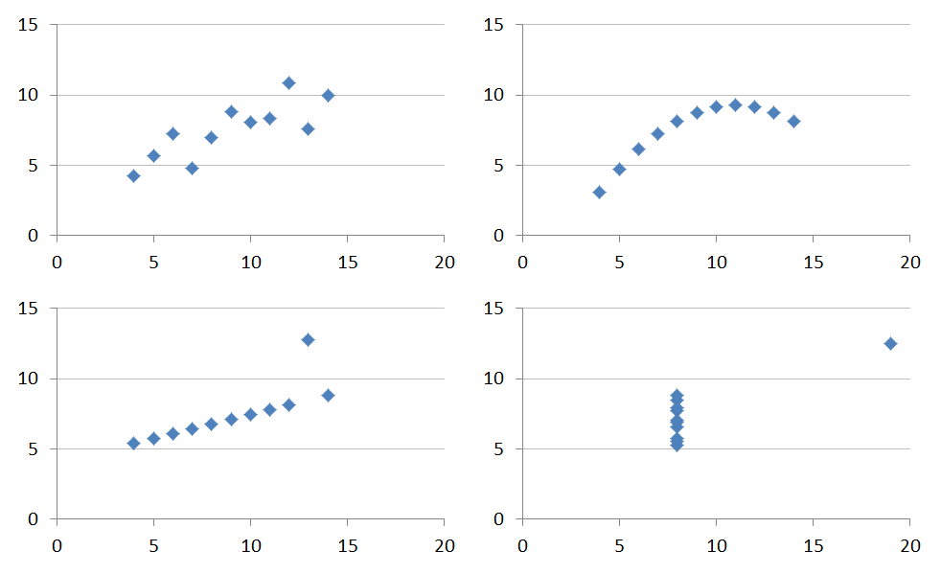
Use graphs and charts to understand relationships in the data
  Responses
Anscombe, F. J.. (1973). Graphs in Statistical Analysis. The American Statistician, 27(1), 17–21. http://doi.org/10.2307/2682899

Slide 31
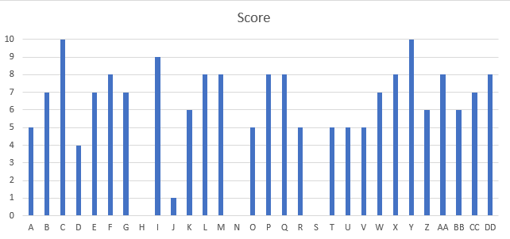
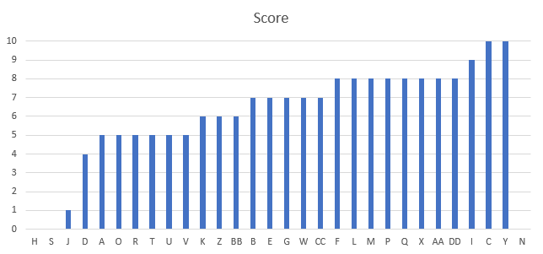
Our dataset has this distribution of scores
  Responses
Best
Worst
Best
Mean: 6.2
Median: 7
Mode: 8
Min: 0
Max: 10
Worst

Slide 32
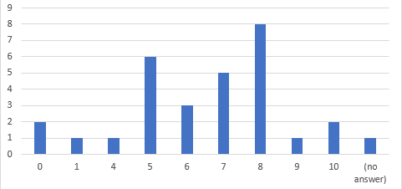
Grouping them a bit may help
  Responses
Best
Worst
Score | Respondents
0 | 2
1 | 1
4 | 1
5 | 6
6 | 3
7 | 5
8 | 8
9 | 1
10 | 2
(no answer) | 1
Grand Total | 30
Best
Mean: 6.2
Median: 7
Mode: 8
Min: 0
Max: 10
Worst

Slide 33
Break

Slide 34
Scoring Likert items
  Responses

Slide 35
We get a lot of analysis challenges like this
  Responses
Q4 How much did you like or dislike the application process?
Strongly dislike
Dislike
Neither dislike nor like
Like
Strongly Like

Slide 36
Dealing with rating questions
  Responses
A ‘Like / Dislike’ question got these responses
  Strongly dislike 2
  Dislike 6
  Neither dislike nor like 14
  Like 31
  Strongly like 13
  Total responses 66
Please work out the percentage of respondents
who are positive about the application process

Slide 37
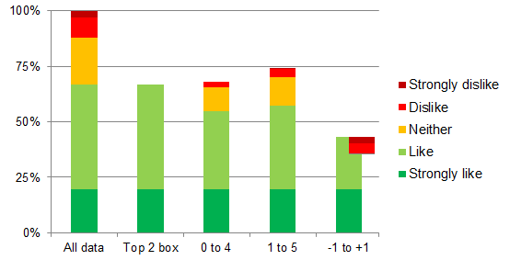
There are many ways to combine ratings into means and percentages
  Responses
47% 31 ticked ‘like’ so 31/66 = 47%
67% ‘Top box’ / ‘top 2 box’ uses the positive responses (31+13) / 66 = 66.6%
68% ‘0 to 4’ weights responses: 0%, 25%, 50%, 75%, 100%
74% Likert’s method ‘1 to 5’ weights responses: 1, 2, 3, 4, 5 (then divide by 5)
36% ‘-1 to 1’ weights responses: -100%, -50%, 0, 50%, 100%
67%
68%
74%
36%

Slide 38
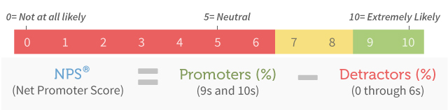
Net Promoter Score® has a special analysis method
  Responses
Image credit: https://www.netpromoter.com/know/

Slide 39
  Responses
Takeaway
Decide on how you will calculate the number(s) in the result BEFORE
you collect the data

Slide 40
Dealing with open answers
  Responses

Slide 41
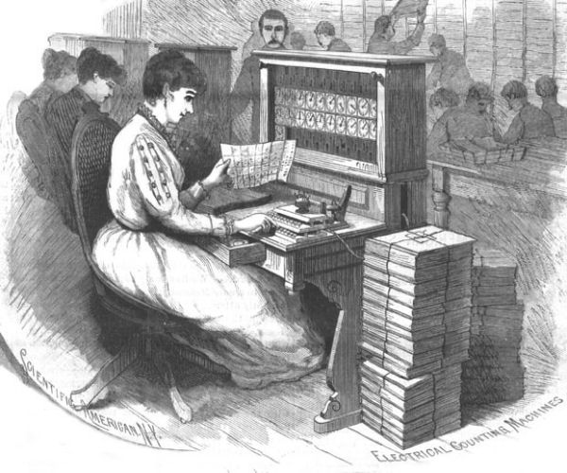
Typing in the answers is “coding”
  Responses
Image credit: https://www.census.gov/history/www/census_then_now/notable_alumni/herman_hollerith.html

Slide 42
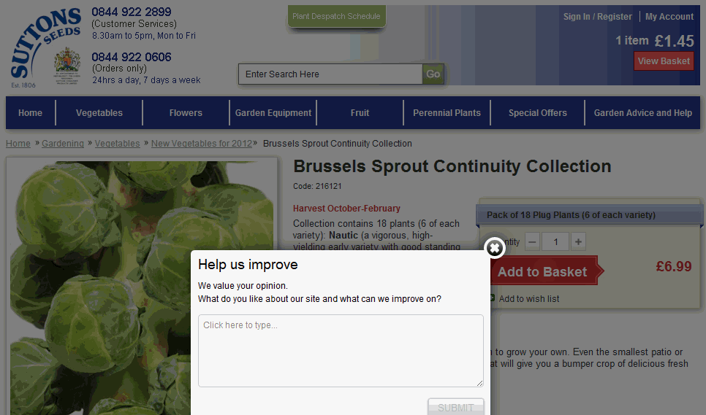
If you ask for answers, plan to read them and think about them
  Responses

Slide 43
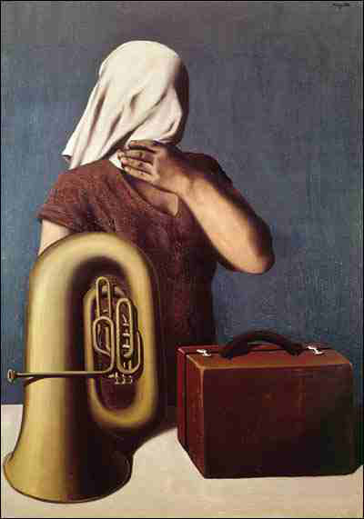
Name four things that appear in this picture
  Responses
René Magritte “L’Histoire centrale” (“The heart of the matter”), Dexia Collection
http://www.cs.man.ac.uk/~jeremy/HealthInf/RCSEd/terminology-rater.htm

Slide 44
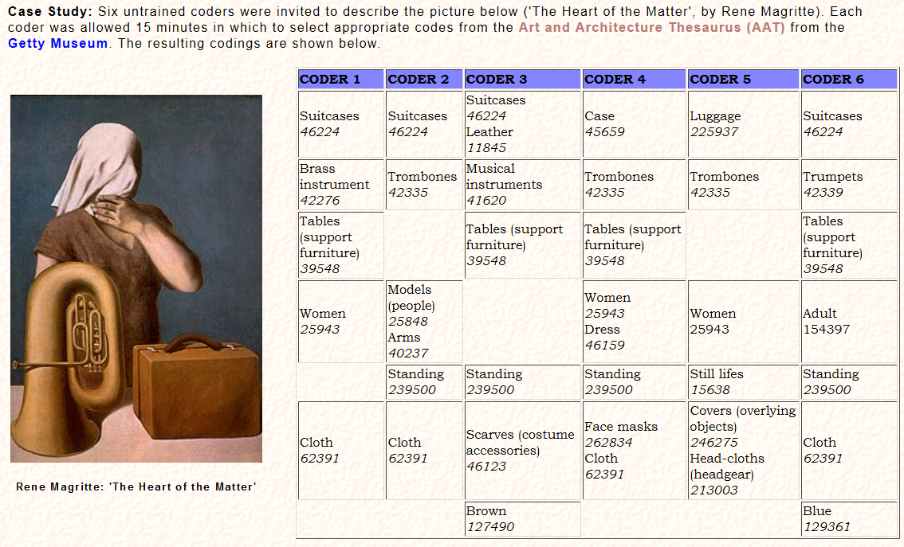
This is from a case study on inter-coder reliability
  Responses
http://www.cs.man.ac.uk/~jeremy/HealthInf/RCSEd/terminology-rater.htm
Notes:
Add in our own coding questions example

Slide 45

You can choose from many different coding frames
  Responses
Topic (as in the museum example)
Positive or negative about something (sentiment)
Who is responsible for doing something (department)
Nuggets for the report (cherry-picking)
Johnny Saldaña lists many more in his book
Image credit: The Coding Manual for Qualitative Researchers | Online Resources (sagepub.com)

Slide 46
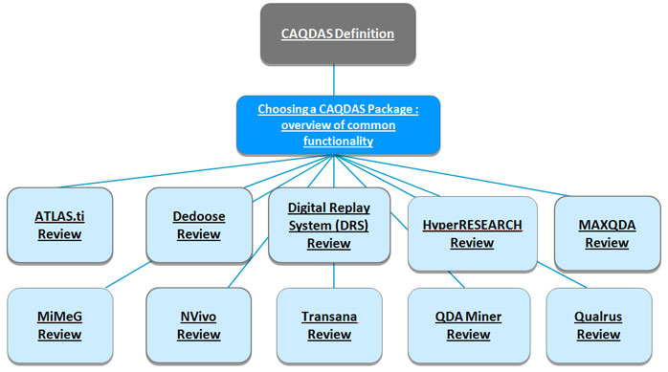
CAQDAS tools can have hefty learning curves
  Responses
Before buying one, look at this: Choosing a CAQDAS package | University of Surrey
Image credit: Choosing an appropriate CAQDAS package - University of Surrey - Guildford (archive.org)
Notes:
computer-assisted qualitative data analysis software

Slide 47

Word clouds can be rather uninteresting
  Responses
from a survey on usability certification

Slide 48
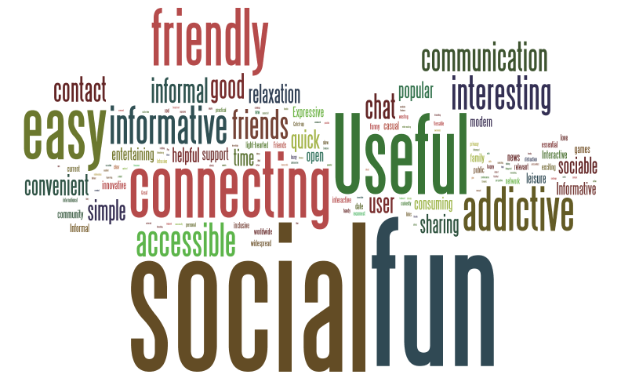
Or they can be handy to get a flavour of answers
  Responses
From a survey about using Facebook in connection with university study
Responses coded ‘positive’

Slide 49
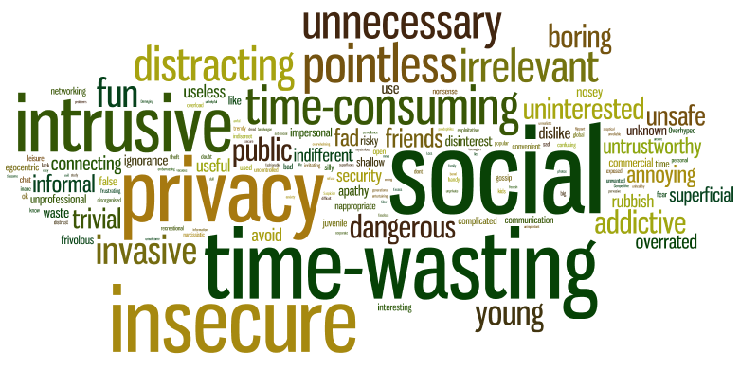
And contrasting with a different flavour of answers
  Responses
From a survey about using Facebook in connection with university study
Responses coded ‘negative’

Slide 50
I do coding for each question in five steps
  Responses
Step 1: Read a sample of the open answers
Step 2: Decide on a coding frame
Step 3: Apply the coding frame (phase 1 coding)
Step 4: Think about it
Step 5: Revise the coding frame and repeat (phase 2 coding)

Slide 51
What I ought to do is different
  Responses
Goals: Decide on a coding frame.
Fieldwork: Apply the coding frame to the first few responses. Think about it. Revise.
Responses: Apply the better coding frame (phase 1 coding).
Think about it.
Reports: Revise the coding frame and tweak it all again
(phase 2 coding).

Slide 52
You’re going to try my real-life method of coding
  Responses
Step 1: Read a sample of the comments
Step 2: Decide on a coding frame
Hint – I mentioned four types of coding frame
  Topic (as in the museum example)
  Positive or negative about something (sentiment)
  Who is responsible for doing something (department)
  Nuggets for the report (cherry-picking)
5 minutes

Slide 53
Let’s see how that works on all the comments
  Responses
  Step 3: Apply the coding frame (phase 1 coding)
  Then we’ll come back and think about it together
  10 minutes

Slide 54
We’ve got to the final step
  Goals
  Sample
  Questions
  Questionnaire
  Fieldwork
  Responses
  Reports
  Establish your goals for the survey
  Decide who to ask and how many
  Test the questions
  Build the questionnaire
  Run the survey from invitation to follow-up
  Clean and analyse the data
  Present the results
Monday
Yesterday
Today

Slide 55
What goes into your report: representativeness
  Reports

Slide 56

If you’re losing people, have you still got representativeness?
  Reports
Image credit: Caroline Jarrett / CorelDraw

Slide 57
We want the final group to be representative
  Reports
Who you want to ask
Mostly people you want to ask
The ones whose
responses you use
Representativeness
Maybe some you didn’t want to ask

Slide 58
Representativeness is the result of many choices
  Reports
Coverage error
Who you want to ask
The list you sample from
Sampling error
Non-response error
The ones you ask
The ones who respond
Adjustment error
The ones whose
responses you use
Representativeness
Notes:
Coverage error happens when some people in the defined group are not in the list you sample from
Sampling error happens when you ask a sample of people from the list, so some people get left out
Non-response error can happen when the people who respond are different from the people who do not respond in a way that affects the overall result of the survey
Adjustment error happens when you make less-than-perfect decisions about including or excluding people who respond
At the end of all of that, what we are aiming for is that the ones whose responses you use are appropriately representative of the people you wanted in the first place

Slide 59
Assess representativeness using something that matters
  Reports
For the Open University students, I used:
Age
Current module
Length of time with the Open University

Slide 60
Assertion/evidence reports
  Reports

Slide 61
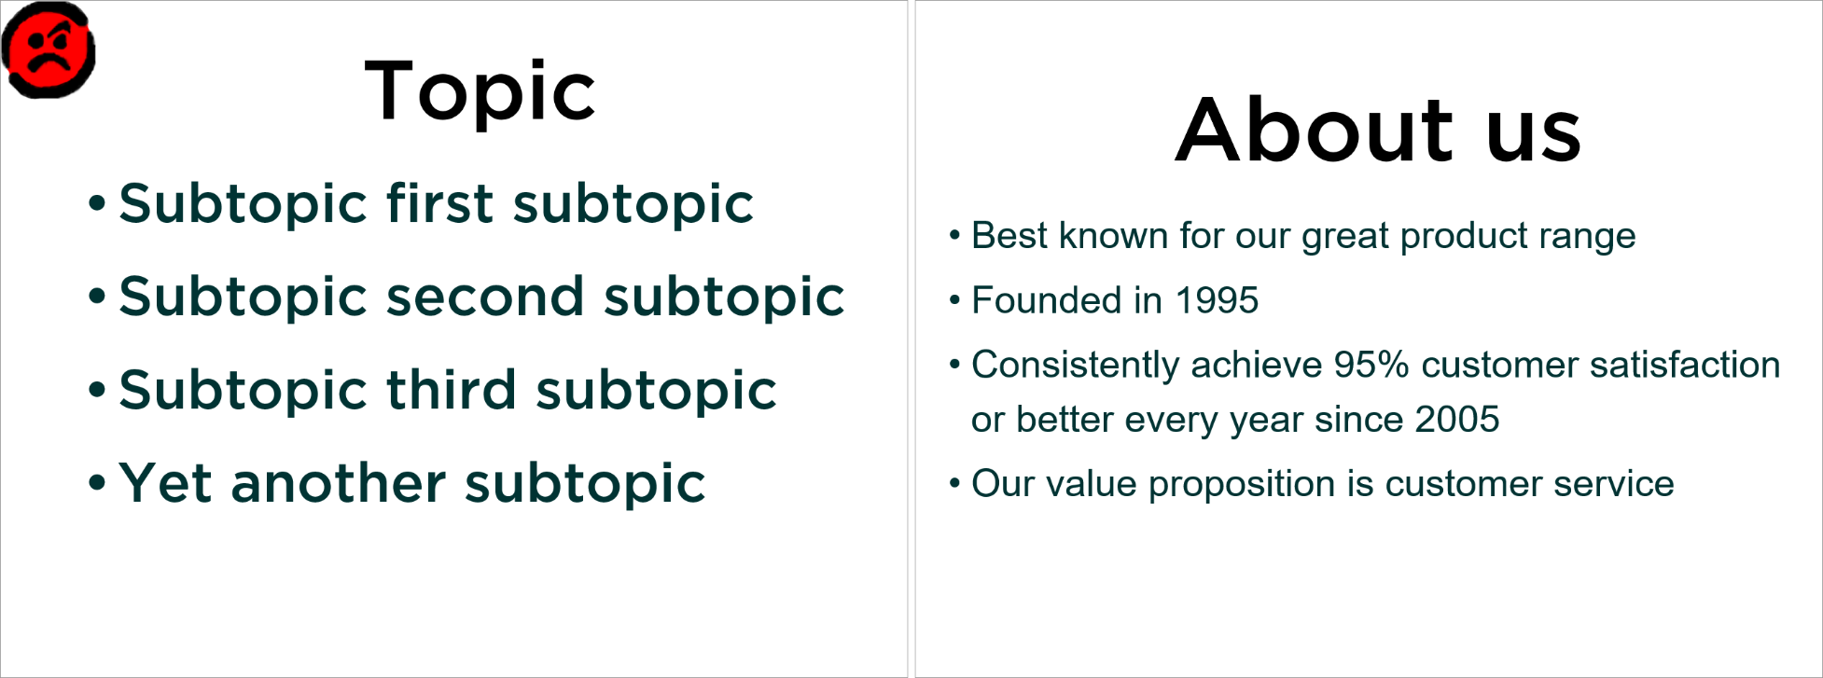
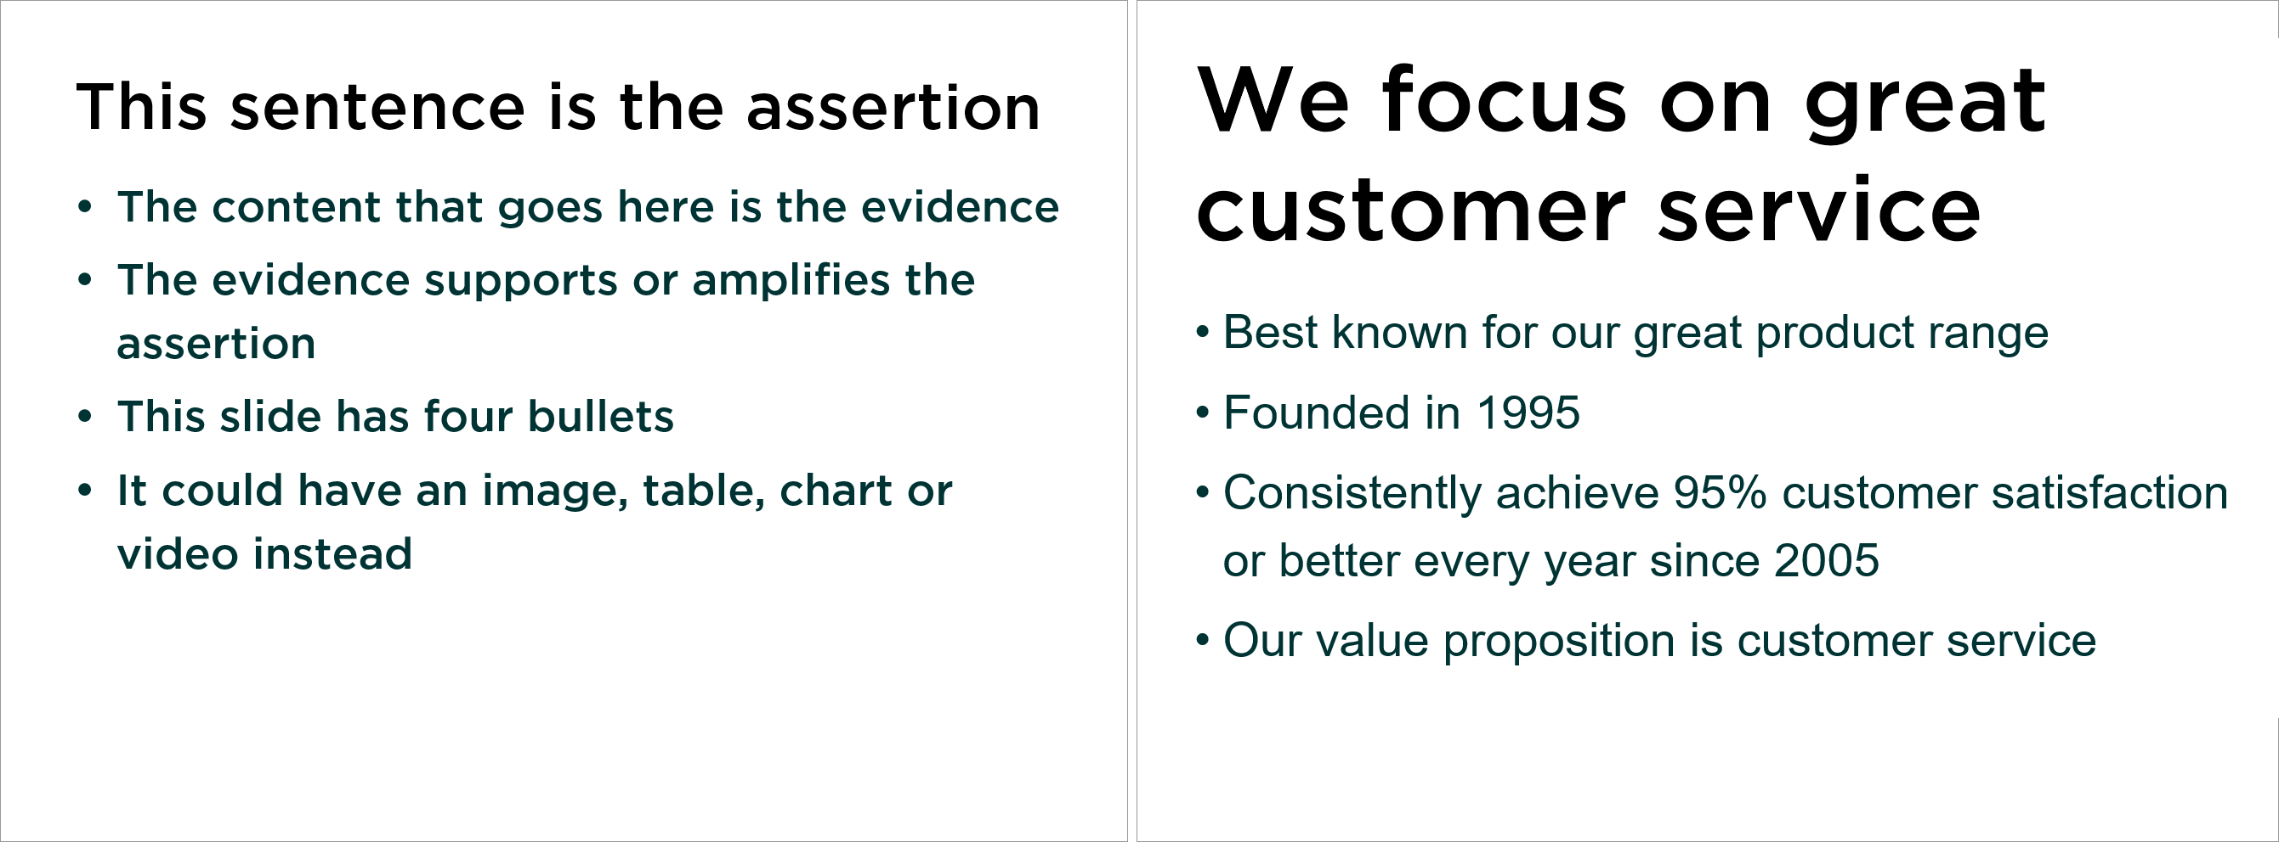
Slides with a single title sentence work better
  Reports

Slide 62
We see a lot of topic/subtopic slides
  Reports

Slide 63
Use assertion/evidence instead
  Reports

Slide 64
Example: we are reporting on survey results
  Reports
The goal for this survey was to do a baseline measurement before deciding whether to do a ‘Share your magazine’ campaign.
The overall aim is to get at least half the magazine’s subscribers to share

Slide 65
Write a better headline for this slide
  Reports
Optional: decide whether to report the answers differently
Including yourself, how many adults usually
read or look through your copy of the magazine?
Choice | Responses
1 | 434
2 | 190
3 | 39
4 | 8
5 | 0
6 or more | 5

Slide 66
I chose to create percentages and a summary
  Reports
About two-thirds of our 676 respondents do not share their magazine
Adults
Don’t share | 65%
Share with 1 other | 28%
Share with 2 or more others | 7%

Slide 67
You might choose a chart
  Reports
About a third of our respondents share their magazine

Slide 68

Another approach: a strong image with a headline
  Reports
65% prefer not to share
Image credit: Photo by JD Mason on Unsplash

Slide 69
Break

Slide 70
What’s the Least You Can Do™?

Slide 71
Here are the 7 steps as a linear process
  Goals
  Sample
  Questions
  Questionnaire
  Fieldwork
  Responses
  Reports
  Establish your goals for the survey
  Decide who to ask and how many
  Test the questions
  Build the questionnaire
  Run the survey from invitation to follow-up
  Clean and analyse the data
  Present the results
  Questions you need answers to
  People you will invite to answer
  Questions people can answer
  Questions people can interact with
  People who actually answer
  Answers
  Decisions

Slide 72
The least you can do is about doing a little
Make every thing really, really small
Go for a Light Touch questionnaire
  One MCQ
  One Burning issue
  Minimal representativeness questions
Make it into a Light Touch survey by turning it around in a day! (ok, maybe a week)

Slide 73
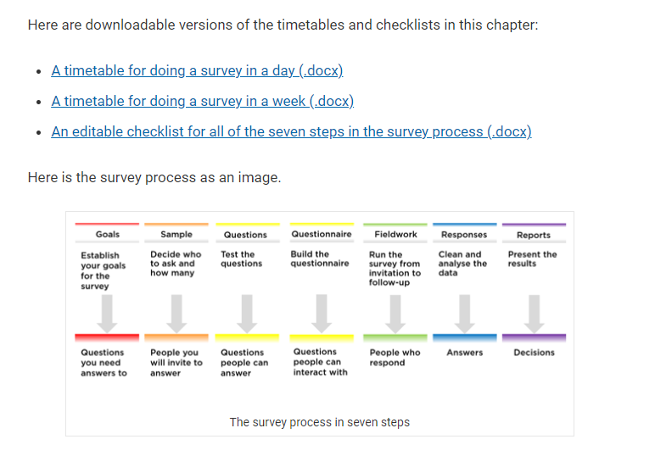
There are downloadable timetables

Slide 74
Let’s have a look at the timetable: the morning
9 a.m. Goals and sample
Decide on your Most Crucial Question.
Define your group of people and decide on your representativeness question.
10 a.m. Questionnaire
Build your questionnaire, including writing your invitation and thank-you page.
Get someone to do a quick usability test. Ask them to “think aloud” so that you get a little bit of cognitive interviewing at the same time.
11 a.m. Fieldwork part 1
Do your pilot test: Send invitations to 10 people, with the request that they respond by 1p.m.

Slide 75
Let’s have a look at the timetable: the afternoon
1 p.m. Fieldwork part 2
Iterate your questionnaire based on your pilot.
Send out the questionnaire to the larger sample, with the request that they respond by 3 p.m.
2 p.m. Responses part 1
Some responses will be back. Start your data cleaning.
3 p.m. Responses part 2
Decide what descriptive statistics you want to use.
Read all open box responses, possibly sorting them according to one of the other answers.
4 p.m. Reports
Create the report you want to deliver.

Slide 76
Should I do this survey?
Do I know how I’m going to use the answers?
Yes
  Is a survey the right way to get the answers?
Yes
  Do I have time to test and to iterate?
Yes
  Do people have answers to these questions?
Yes
Do people want to respond to my request?
Go
Yes
Notes:
Is this the only way I can get this data?
If yes:
Do users want to talk to us about these topics?
If yes:
Do users have answers to these questions?
If yes:
Do I have time to do a pilot?
If yes:
Do I know how I’m going to use the answers?
GO

Slide 77
All these errors add up to Total Survey Error
Why you want ask
Who you want to ask
Coverage error
(Lack of) validity
Sampling error
Measurement error
Non-response error
Processing error
Adjustment error
The number
Notes:
The octopus again; we've looked at 6 of the 8 tentacles.

Slide 78
The aim is to get the best number you can, within the resources you have
Why you want to ask
Who you want to ask
The reason you’re doing it
The list you sample from
The sample you ask
The questions you ask
The ones who respond
The answers you get
The ones whose
responses you use
The answers you use
The number
Notes:
This is a more conventional way of looking at the octopus tentacles

Slide 79
The aim is to minimise Total Survey Error
Why you want to ask
Who you want to ask
Coverage error
The reason you’re doing it
The list you sample from
Sampling error
(Lack of) validity
The sample you ask
Non-response error
The questions you ask
Measurement error
The ones who respond
The answers you get
Adjustment error
Processing error
The ones whose
responses you use
The answers you use
The number
Notes:
This is a more conventional way of looking at the octopus tentacles

Slide 80
Survey methodologists use more searchable terms
Representation
Target population
Measurement
Coverage error
Construct
Sampling frame
Sampling error
(Lack of) validity
Sample
Non-response error
Measurement
Measurement error
Respondents
Response
Adjustment error
Processing error
Postsurvey adjustments
Edited response
Survey statistic
Notes:
This is a more conventional way of looking at the octopus tentacles

Slide 81
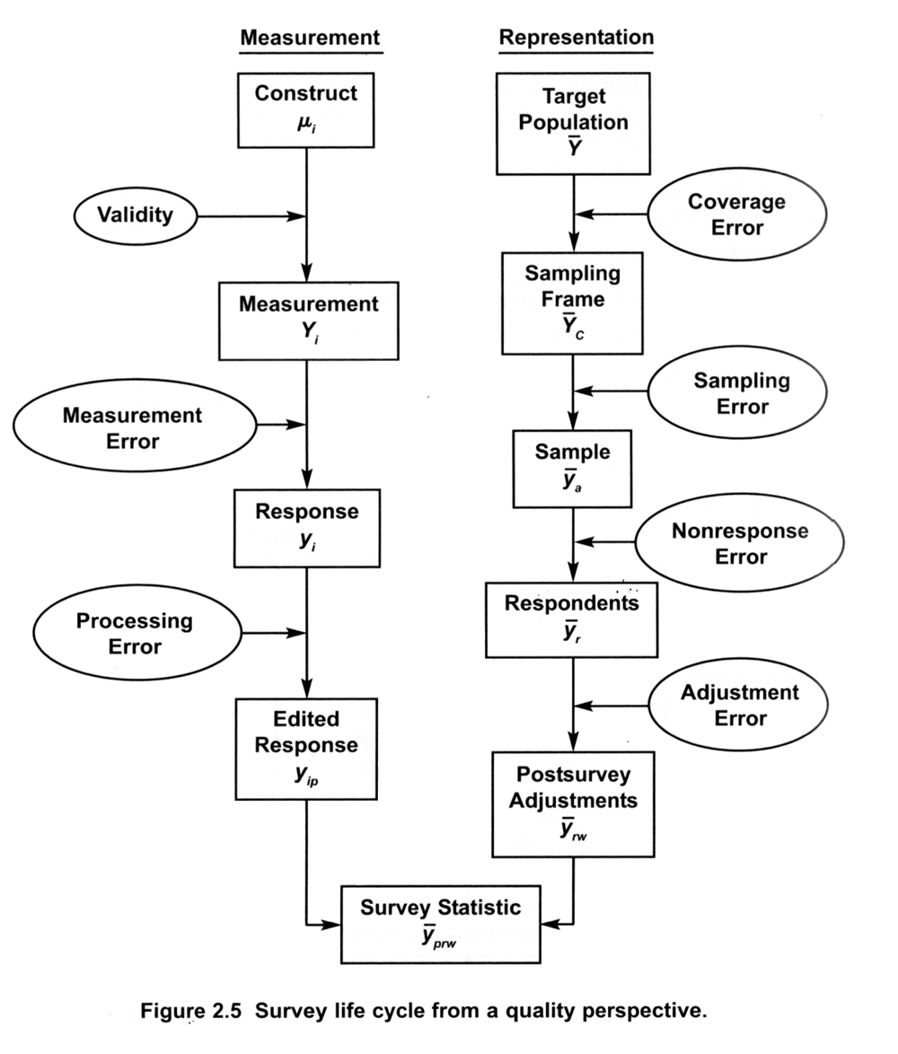
Total Survey Error diagram as presented in
Groves, R. M., F. J. Fowler, M. P. Couper, J. M. Lepkowski, E. Singer and R. Tourangeau (2009).
Survey methodology. Hoboken, N.J., Wiley.

Slide 82
Wrap

Slide 83
Please do my final EasyRetro
The EasyRetro has the columns we used previously:
  Anything useful from today
  Not useful / confusing / could have skipped
  Want to know but hasn't yet come up
  Has come up but want more
Extra for today
  Comments on the entire three days

Slide 84

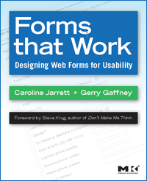

Caroline Jarrett
@cjforms
https://www.effortmark.co.uk
carolinej@effortmark.co.uk

