Slide 1
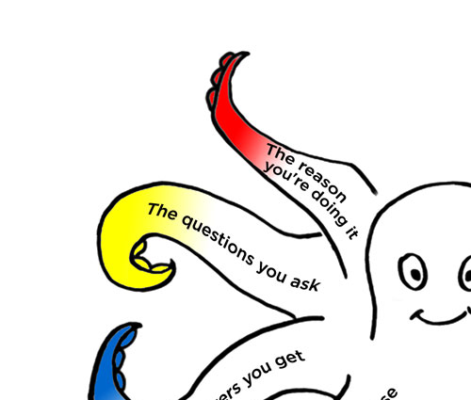
Surveys that work
Session 2 of 3
An introduction to
the Survey Octopus
and Total Survey Error
Caroline Jarrett
@cjforms
#surveysthatwork2022

Slide 2
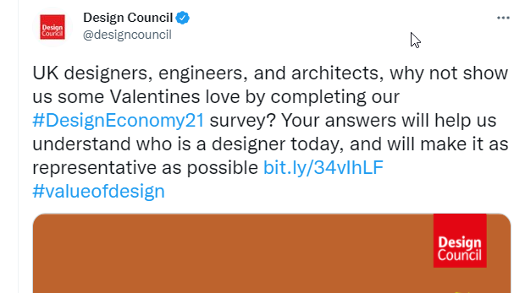
Yesterday included representativeness (and this)
Notes:
Note that this is a survey invitation from 2022, but the hashtag relates to 2021. Also, increasing the response does not necessarily make it more representative. What happens if this attracts 20 designers, 200 engineers, and 2000 architects? What if the extra response comes from an extra 1000 engineers?

Slide 3

Opening page of the survey, no comment
Notes:
Calling all UK Designers, Architects, and Engineers
Design Economy 2021 is Design Council’s most ambitious research project to date. This three-year programme – with its interactive, digital format – will be a growing resource for policy makers, business leaders, public sector professionals, architects and designers.
As well as assessing the current state of design in the UK, Design Economy 2021 will explore the role that design can play to ‘build back better’ and create a more just, healthy and regenerative world.
Over the months ahead, Design Council will be curating new data, evidence, stories and toolkits to champion design and further its use. Readers will be invited to become co-researchers and collaborators, rather than simply recipients of the research.
We’ll have an ongoing focus on equality, diversity and inclusion, encouraging questions about how well design is responding to people’s different wants and needs, its vital role in levelling up the UK’s regional economies, and the changes needed to ensure that design works for everyone.
We want to make the Design Economy as representative of every designer as possible. Unfortunately, national datasets aren't always as inclusive as they could be. That's why we have decided to launch a new survey, to better understand who is a designer today, what their personal and professional backgrounds are, and what kind of design they practise.
Some of these questions are quite personal, and you are able to skip any that you would prefer not answering.
**IT TAKES ONLY FIVE MINUTES TO COMPLETE.**
We will share all results of this survey in May 2022.
When you've finished, could you forward this to other designers you know? We want to get as many responses from as many different designers as possible.
All the information we collect will be anonymised before data analysis, and will be kept confidential and secure in line with GDPR and our data privacy policy. If you want to get in touch with us about the survey, please contact research@designcouncil.org.uk.

Slide 4
Here are the 7 steps as a linear process
  Goals
  Sample
  Questions
  Questionnaire
  Fieldwork
  Responses
  Reports
  Establish your goals for the survey
  Decide who to ask and how many
  Test the questions
  Build the questionnaire
  Run the survey from invitation to follow-up
  Clean and analyse the data
  Present the results
  Questions you need answers to
  People you will invite to answer
  Questions people can answer
  Questions people can interact with
  People who actually answer
  Answers
  Decisions

Slide 5
Today is questions day
  Goals
  Sample
  Questions
  Questionnaire
  Fieldwork
  Responses
  Reports
  Establish your goals for the survey
  Decide who to ask and how many
  Test the questions
  Build the questionnaire
  Run the survey from invitation to follow-up
  Clean and analyse the data
  Present the results
Yesterday
Today
Tomorrow

Slide 6
Start with why and who; end with the number
  Questions
Why you want to ask
Who you want to ask
The survey is a
process for getting answers to questions
The number

Slide 7
Yesterday we looked at numbers of people
  Questions
Why you want to ask
Who you want to ask
Asking one person the
right question
Asking 10,000 people the
wrong question
is better than
The number

Slide 8
Today we’ll think about questions
  Questions
Asking one person the
right question

Slide 9
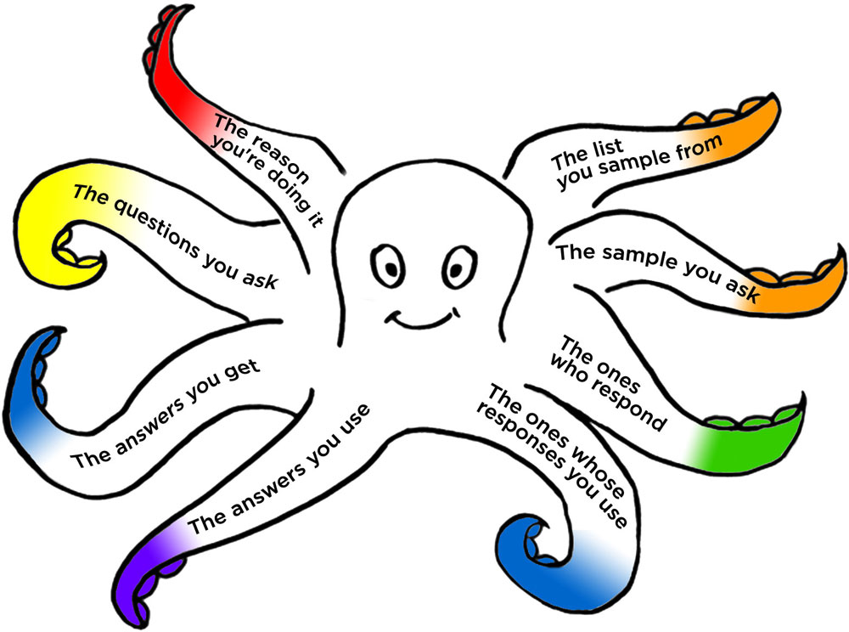
Questions relate to the reason you’re doing it
  Questions
Questions:
What are you
asking about?
How many questions?

Slide 10
Lack of validity is a mismatch between what you ask and what you need to know
  Questions
(Lack of) validity

Slide 11
There are four steps to answer a question
  Questions
Understand
Find
Decide
Place
Read and (ideally) make sense of the question
Know an answer, retrieve it from memory, look it up or puzzle something out
Decide whether to reveal that answer to the questioner
Type, click or say the answer to the questioner
Adapted from Tourangeau, R., Rips, L. J. and Rasinski, K. A. (2000)
“The psychology of survey response”

Slide 12
A good question is good in four ways
  Questions
Step | A good question …
1. Read and understand | is legible and makes sense
2. Find an answer | asks for answers that we know or can find easily
3. Decide on the answer | asks for answers we’re happy to reveal
4. Place the answer | offers appropriate spaces for the answers
Adapted from Tourangeau, R., Rips, L. J. and Rasinski, K. A. (2000)
“The psychology of survey response”

Slide 13
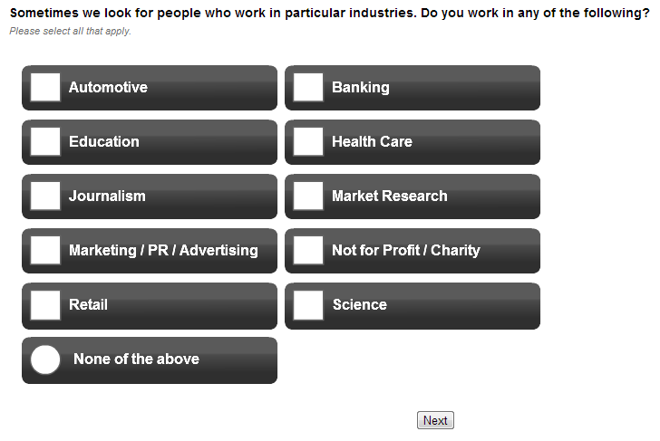
Four step examples: 1: read and understand
  Questions
Hermann grid illusion

Slide 14
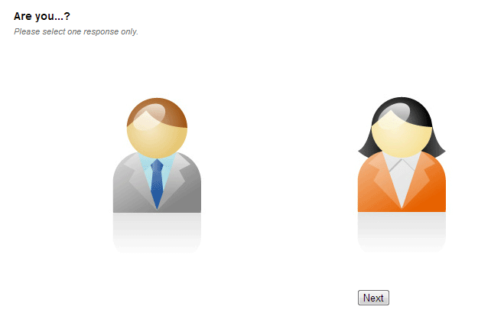
Four step examples: 1: read and understand
  Questions

Slide 15
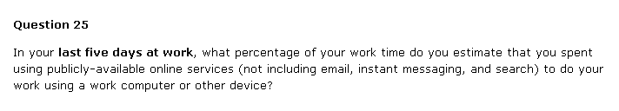
Four step examples: 2: find the answer
  Questions

Slide 16
Do you say your name differently?
  Questions
“What is your name?”
  In a formal context – applying for a job
  In a social context – meeting the friend of a friend
  On the phone – getting a delivery sorted out

Slide 17
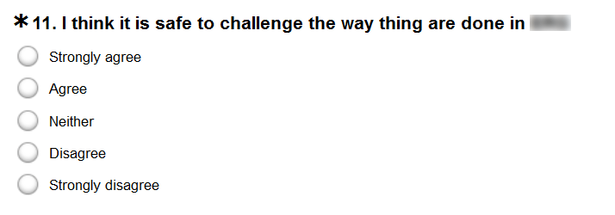
Four step examples: 3: decide on the answer
  Questions

Slide 18
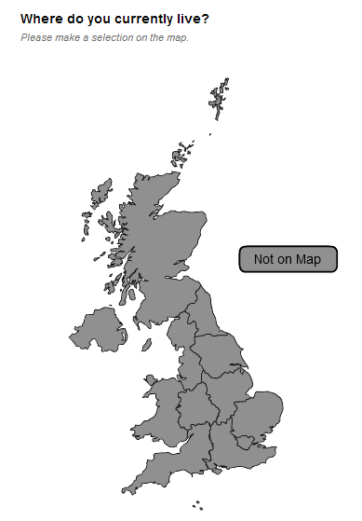
Four step examples:
4: place the answer
  Questions

Slide 19
We’ve looked at four separate steps
  Questions
Understand
Find
Decide
Place
Adapted from Tourangeau, R., Rips, L. J. and Rasinski, K. A. (2000)
“The psychology of survey response”

Slide 20
The steps can happen instantly
  Questions
What is your name?
Can we ask you a few questions today?

Slide 21
Sometimes the four steps take a long time
  Questions
Tell us why you are a good candidate for this job
Report your full taxable income
Provide us with a cash-flow analysis for the next five years

Slide 22
Estimating routine work tasks is really difficult
  Questions
In your last five days at work, what percentage of your work time do you estimate that you spent using publicly-available online services (not including email, instant messaging and search) to do your work using a work computer or other device?

Slide 23
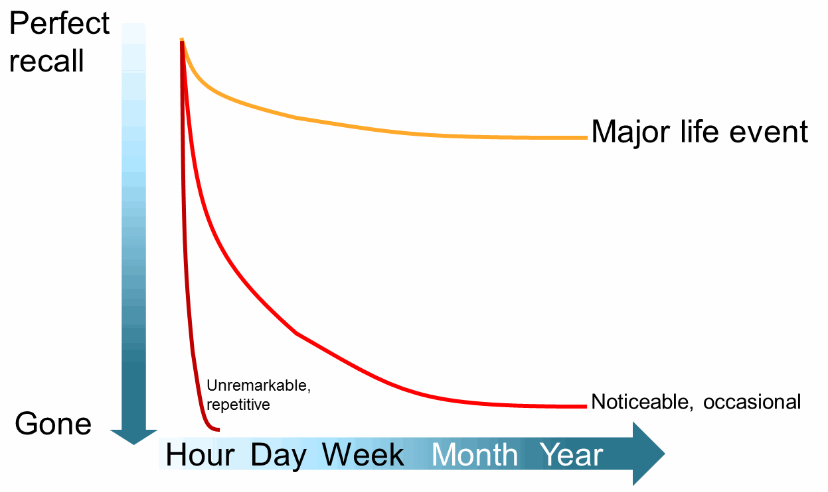
There is an approximate curve of forgetting
  Questions

Slide 24
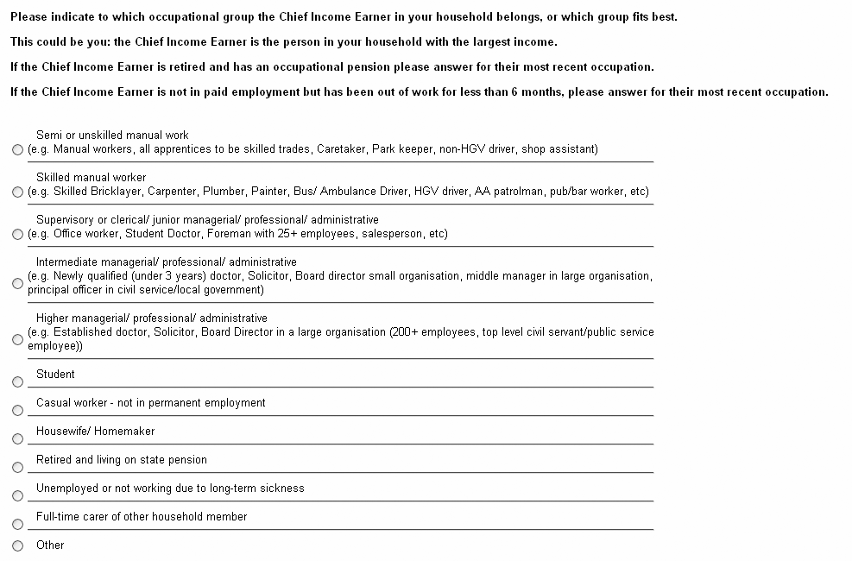
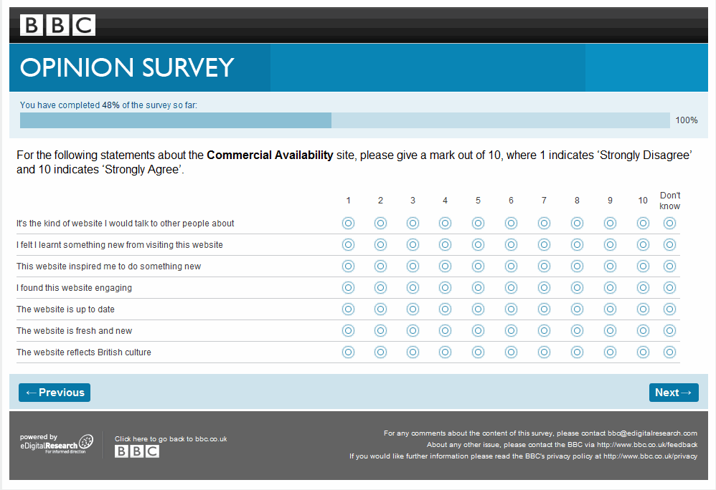
Let’s practice finding problems at each step
  Questions
I’ve chosen two examples from my library
Have a look at them in your groups on Mural
Make notes about any problems you spot at each of the four steps:
  Understand
  Find
  Decide
  Place
5 minutes

Slide 25
What did we think of this one?

Slide 26
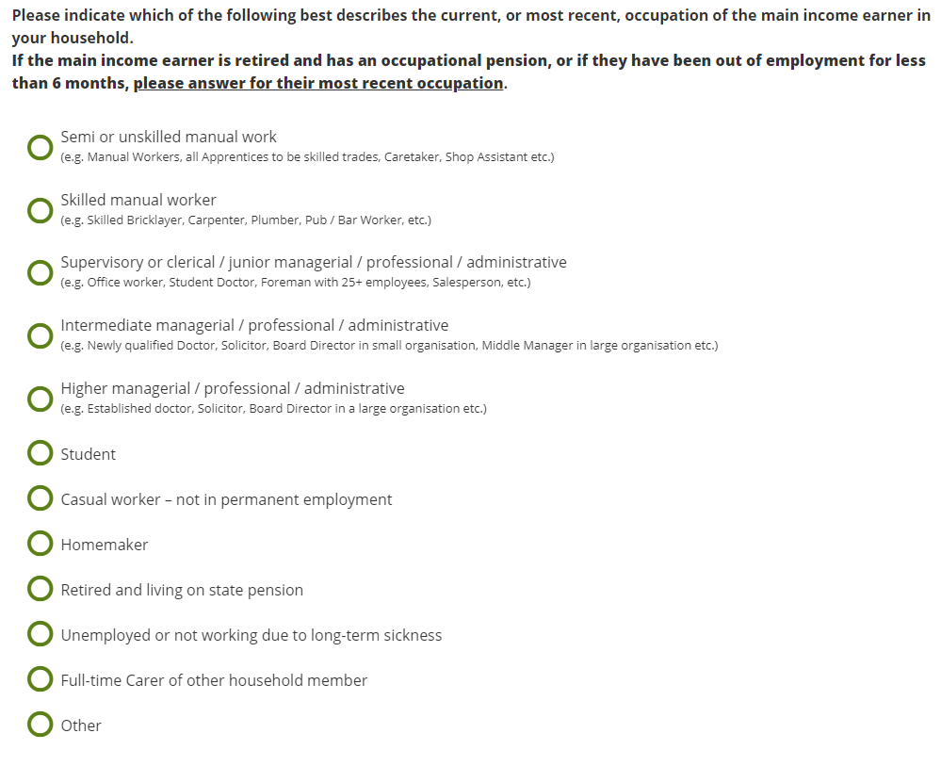
I got almost the same question last week

Slide 27
And this one?
  Questions

Slide 28
Grids are a major cause of survey drop-out
  Questions
Source: Database of 3 million+ web surveys conducted by Lightspeed Research/Kantar
From Coombe, R., Jarrett, C. and Johnson, A. (2010) “Usability testing of market research surveys” ESRA Lausanne

Slide 29
But it’s the topic that matters most
  Questions
Source: Database of 3 million+ web surveys conducted by Lightspeed Research/Kantar
From Coombe, R., Jarrett, C. and Johnson, A. (2010) “Usability testing of market research surveys” ESRA Lausanne

Slide 30
A good question is good in four ways
  Questions
Step | A good question …
1. Read and understand | is legible and makes sense
2. Find an answer | asks for answers that we know or can find easily
3. Decide on the answer | asks for answers we’re happy to reveal
4. Place the answer | offers appropriate spaces for the answers
Adapted from Tourangeau, R., Rips, L. J. and Rasinski, K. A. (2000)
“The psychology of survey response”

Slide 31
Try a person-led review to check your questions
  Questions
Very often, the survey process starts with a draft questionnaire
I do a lot of person-led reviews with clients and colleagues

Slide 32
A “person-led expert review” starts with stories
  Questions
Each attendee writes a ‘once upon a time’ story:
Choose the name of a person
Write:
  something about them
  why they are responding to this questionnaire
(optional: everyone shares the story that they wrote)

Slide 33
Now try answering the questionnaire
  Questions
Go through the questionnaire,
answering ONLY from the
point of view of that person
  Keep notes!
When all the attendees have
completed the questionnaire,
compare answers
Person-led
Expert review

Slide 34
Let’s try it. First, the person-led bit.
  Questions
Our stakeholders have said:
“We want to know what users think about our new funding application process”
They have brought a draft questionnaire to a meeting.
Choose the name of a person
Write something about:
  Who the person is
  Their experience with the funding application process
Person-led

Slide 35
Now note your person’s answer to this question
  Questions
Application Process - Feedback Survey
Section 1: About you
Thank you for taking the time to provide feedback on the application process.
Q1 Who submitted your application?
I did
Family member
Paid professional, such as accountant

Slide 36
Note your person’s answers to Q2 and Q3
  Questions
Q2 Who is completing this survey?
I did
Family member
Accountant or adviser
Q3 What motivated you to apply?
_____________________________________________________________________________________________________________________

Slide 37
Note your person’s answers to Q4
  Questions
Section 2: The application process
Q4 How satisfied are you with the application process, on a scale from 0 to 10 where ‘0’ means ‘not at all satisfied’ and 10 means ‘completely satisfied’?
0
1
2
3
4
5
6
7
8
9
10

Slide 38
Note your person’s answers to Q5
  Questions
Q5 Please use the box below to provide us with your feedback on the application process.
Max: 500 characters
________________________________________________________________________________________________________________________________________________________________________________________________________________________________________________________________________________________

Slide 39
Note your person’s answers to Q6
Q6 Were you aware of, and did you make use of, the following:
Tick all that apply
  Questions
 | I wasn't aware this was an option | I was aware of this but didn't use it | I was aware of it and made use of it
Content on our website
Videos on our YouTube channel
Q&A session
Customer Contact Centre
Discussing with a colleague
News media
Talked to an adviser or accountant

Slide 40
Let’s compare answers
  Questions
Were any of those questions problematic for your “person”?
  Please discuss in your groups
  You can edit / add notes / comment in the copy
  Report back with your views
  10 minutes
Expert review

Slide 41
Workshops can go in different directions
  Questions
BACK to thinking about goals and sample
FORWARD to understanding and drafting better questions
SIDEWAYS to testing with real people

Slide 42
BREAK

Slide 43
Measurement error comes from mismatches between the questions you ask and the answers that people give you
  Questionnaire
Measurement error

Slide 44
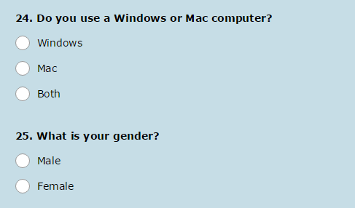
These two questions are quite common
  Questionnaire
Notes:
Two questions from a survey:
'24: Do you use a Windows or Mac computer'?
'25. What is your gender'?

Slide 45
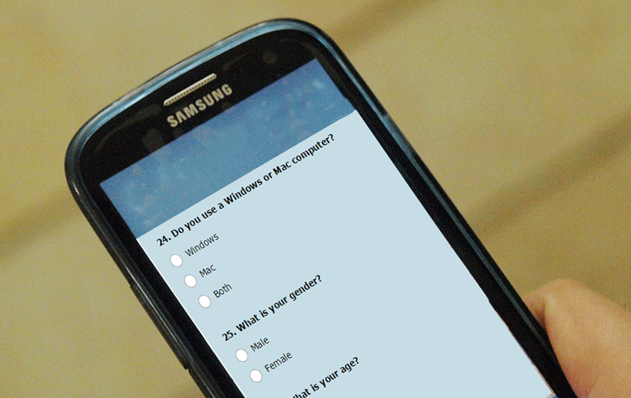
One of them does not work in this context
  Questionnaire
"Phone photography" by Petar Milošević - Own work. Licensed under CC BY-SA 3.0 via Commons - https://commons.wikimedia.org/wiki/File:Phone_photography.jpg#/media/File:Phone_photography.jpg
Modified by Caroline Jarrett

Slide 46
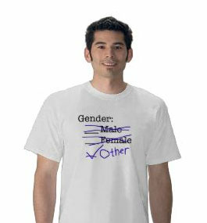
  Questionnaire
Takeaway
Always allow for
something else
Design by @RickyBuchanan; t-shirt from nopitycity.com or zazzle.co.uk
Notes:
A model wears a t-shirt with Gender: 'Male' (crossed out), 'Female' (crossed out) and 'Other' (added and ticked'.

Slide 47

Aside: I’m constantly saying “No yes/no”
  Questionnaire
The real world is analogue
There are nearly always other answers
Try spelling out what “yes” and “no” mean
No yes/no questions - Effortmark

Slide 48



  Questionnaire
Takeaway
Test your questions by interviewing in context

Slide 49
“Place the answer” is also about using the right widget to collect the answer
  Questionnaire
Use | For
Radio buttons | A single answer where you have researched all the possibilities (known answers)
Check boxes | Multiple known answers
Text boxes | Answers where you do not know all the possibilities Answers that the person ‘just knows’ and can type easily Answers where you hope that the person will want to write more

Slide 50
Open boxes often work better than bands
  Questionnaire
If the answer is a routine one that the person ‘just knows’, it can be easier for them to type rather than hunt through options
Examples of questions that have done better:
  How old are you?
  What is the size of your farm?
  How much would you pay for this certification?

Slide 51
An excursion into Likert scales
  Questionnaire

Slide 52
We’ve looked at a Likert item
  Questionnaire
Section 2: The application process
Q4 How satisfied are you with the application process, on a scale from 0 to 10 where ‘0’ means ‘not at all satisfied’ and 10 means ‘completely satisfied’?
0
1
2
3
4
5
6
7
8
9
10

Slide 53
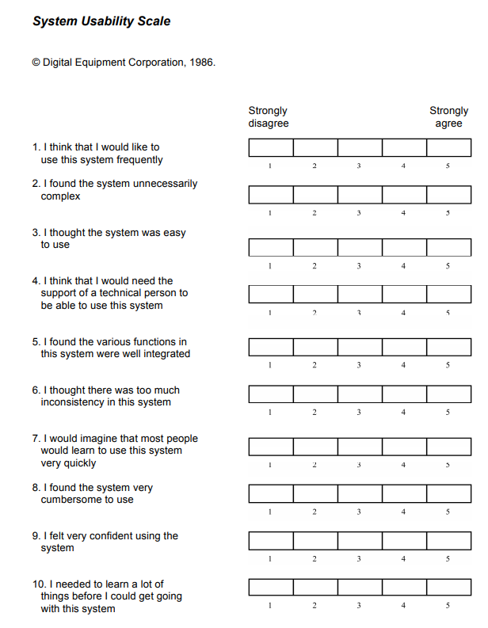
A Likert scale has several Likert items
Likert item
Likert scale
Statement
Response points

Slide 54

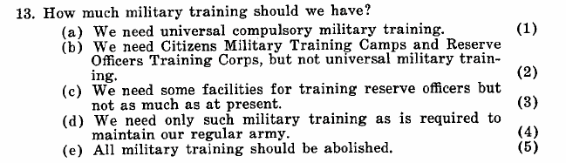
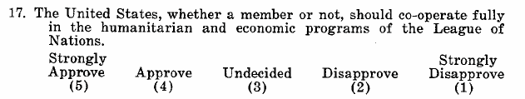
Likert had three formats in his scales
  Questionnaire

Slide 55
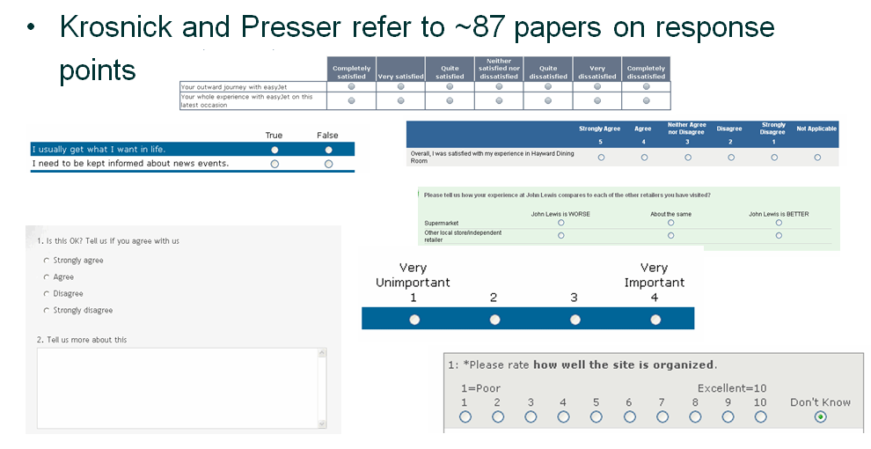
You can find an academic paper to support almost any number of response points
  Questionnaire
Krosnick, J. A. and S. Presser (2009). Question and Questionnaire Design.
Handbook of Survey Research (2nd Edition) J. D. Wright and P. V. Marsden, Elsevier.
Emerald_HSR-V017_9 263..313 (stanford.edu)
Notes:
Krosnick and Presser refer to ~87 papers on response points.
This selection of questions from different surveys has:
One with seven response points in the range
One with two response points (yes/no)
One with five response points plus ‘not applicable’
One with three response points
One with four response points plus a comment box
One with four response points on their own
One with 10 response points plus ‘Don’t Know’

Slide 56
I have a flowchart to help you to decide
  Questionnaire
Does a key stakeholder* have a strong opinion?
Go with the
stakeholder’s opinion
Yes
No
Offer five points with a neutral centre point
*the key stakeholder could be you
Adapted from Caroline Jarrett, “Surveys that work: A practical guide for designing and running surveys”

Slide 57
Is ‘satisfaction’ the only relevant emotion?
  Questionnaire
Section 2: The application process
Q4 How satisfied are you with the application process, on a scale from 0 to 10 where ‘0’ means ‘not at all satisfied’ and 10 means ‘completely satisfied’?
The Microsoft Product Reaction Cards have lots more
Accessible | Creative | Fast | Meaningful | Slow
Advanced | Customizable | Flexible | Motivating | Sophisticated
Annoying | Cutting edge | Fragile | Not Secure | Stable
Appealing | Dated | Fresh | Not Valuable | Sterile
Microsoft Product Reaction Cards Unlock User Satisfaction - Part I (uxfirm.com)

Slide 58
Decide on which emotion(s) you might assess
  Questionnaire
Please discuss in your groups
Report back with your choice(s) – or decision to do none
5 minutes

Slide 59
Now it’s time to make the questionnaire
  Questionnaire
We have the draft that we reviewed today
Let’s think a bit about some topics from yesterday
  Most Crucial Question
  Burning Issue
  Representativeness questions

Slide 60
The Most Crucial Question comes from goals
  Questionnaire
The stakeholder (me) has chosen the Most Crucial Question:
  “What is your overall score for the application process?”
I want a number! That’s my primary goal
As questionnaire designers, you need to decide how to ask the question. You may be able to convince me that there is a better wording.

Slide 61
The Burning Issue question comes from users
  Questionnaire
We haven’t yet had the opportunity to interview any users for their Burning Issues
You will have to choose or write a question that allows for unknown Burning Issues

Slide 62
The representativeness questions ought to come from your work thinking about who you want to ask
  Questionnaire
Here are some suggestions:
  Did you finish the application?
  What sort of work do you do?
  Is this grant for your own organisation / business or are you a professional helping someone else?
You may think of others

Slide 63
Now create a questionnaire
  Questionnaire
Write your version of the MCQ
  “What is your overall score for the application process?”
Decide on, or write, a question that allows for Burning Issues
Decide on, or write, representativeness question(s)
Decide whether to keep or remove any other questions in the draft
Report back with your choice(s) – or decision to do none
15 minutes

Slide 64
Break

Slide 65
Fieldwork
  Fieldwork
Getting the questionnaire to people

Slide 66
Here are the 7 steps as a linear process
  Fieldwork
  Goals
  Sample
  Questions
  Questionnaire
  Fieldwork
  Responses
  Reports
  Establish your goals for the survey
  Decide who to ask and how many
  Test the questions
  Build the questionnaire
  Run the survey from invitation to follow-up
  Clean and analyse the data
  Present the results
  Questions you need answers to
  People you will invite to answer
  Questions people can answer
  Questions people can interact with
  People who actually answer
  Answers
  Decisions

Slide 67
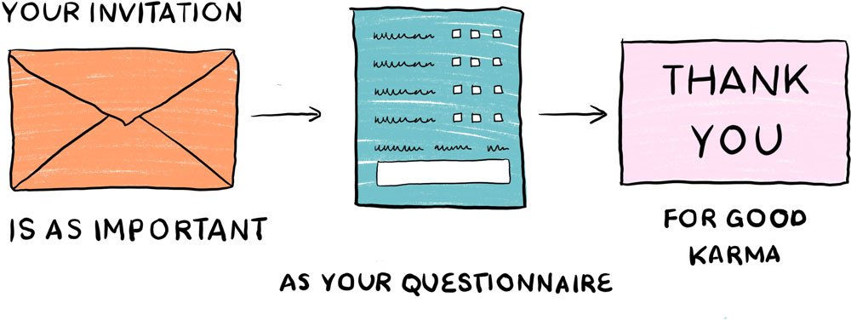
Create the right context for your questionnaire
  Fieldwork
Illustration by Tasia Graham for “Surveys that work: A practical guide for designing better surveys” by Caroline Jarrett

Slide 68
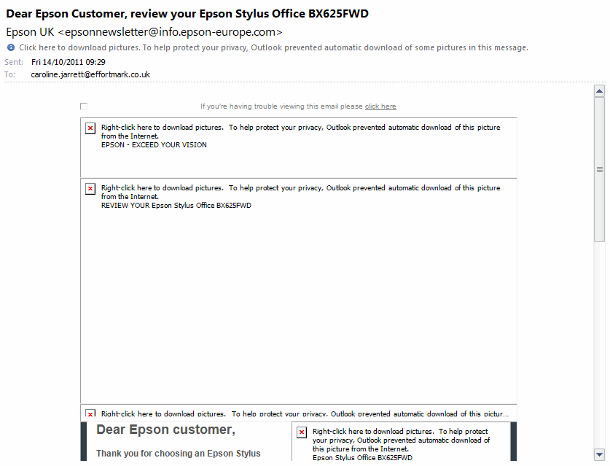
  Fieldwork
Your invitation is important

Slide 69
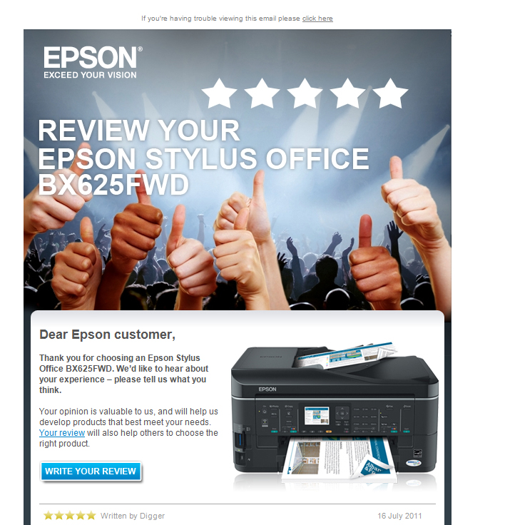
  Fieldwork
I think this invitation is trying to sway the response

Slide 70
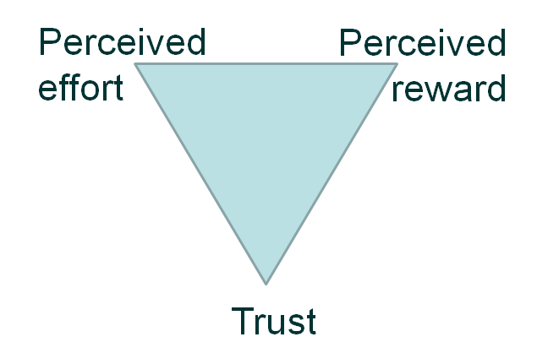
Response relies on effort, reward, and trust
  Fieldwork
People will only respond if they trust you. After that, it's a balance between the perceived reward from filling in the survey compared to the perceived effort that's required. Strangely enough, if a reward seems 'too good to be true' that can also reduce the response.
Diagram from Jarrett, C, and Gaffney, G (2008) “Forms that work: Designing web forms for usability”
inspired by Dillman, D.A. (2000) “Internet, Mail and Mixed Mode Surveys: The Tailored Design Method”

Slide 71
A good invitation creates trust
  Fieldwork
Consider whether your branding could sway the response
  Are you a brand that has a high profile?
  Are you likely to be known to the person who answers?
  Can you get sponsorship from a trusted person or organisation?
Say who you are
Say why you’ve contacted this person specifically
Explain:
  Your privacy policy
  Your approach to anonymity and confidentiality

Slide 72
A good invitation offers a perceived reward
  Fieldwork
Explain the purpose of the survey
Explain why this person’s responses will help
If there is an incentive, offer it
  Incentives do not have to be financial
  If the incentive is financial, make sure it is easy to get (otherwise you increase perceived effort)

Slide 73
A good invitation explains the effort
  Fieldwork
Outline the topic of the survey
Say when the survey will close
Consider saying how many questions there are
Do NOT say how long it will take
  unless you have tested the heck out of it and
  are extremely sure that you know the answer

Slide 74
Write the invitation and thank-you
  Fieldwork
Hints:
  Consider your privacy policy
  Decide on your approach to anonymity and confidentiality
  The invitation can be part of the questionnaire
  Thank-you is usually on a separate page
10 minutes

Slide 75
Testing your questionnaire
  Fieldwork

Slide 76
Testing with users is essential
  Fieldwork
Review with stakeholders
Testing with users
Goals to decisions
Person-led expert review
Pilot study
Usability test
Cognitive test
Cogability test

Slide 77
Test it: pilot study
  Fieldwork
Run the survey from invitation to the follow-up
Look for mechanical problems like:
  wrong link in the invitation
  no thank-you page
Find out what your response rate is
so that you can work out your sample size
“If you don’t have time to do a pilot study, you don’t have time to do the survey”

Slide 78

Do usability testing on your questionnaire
  Fieldwork
Get someone to answer your questionnaire while you watch
Illustration by Tasia Graham for “Surveys that work: A practical guide for designing better surveys” by Caroline Jarrett

Slide 79

Do cognitive testing on your questions
  Fieldwork
Where did ‘I’m not sure’ come from?
Was it an interaction problem?
What is this person thinking?
Illustration by Tasia Graham for “Surveys that work: A practical guide for designing better surveys” by Caroline Jarrett

Slide 80
You’re looking out for problems at each step
  Fieldwork
Understand
Find
Decide
Place
Adapted from Tourangeau, R., Rips, L. J. and Rasinski, K. A. (2000) “The psychology of survey response”
Notes:
The four steps are:
Read and understand the question
Find the answer
Judge whether the answer you’ve found aligns with what you say and the way you want to portray yourself
Place the answer on the form (or give it to the interviewer)

Slide 81
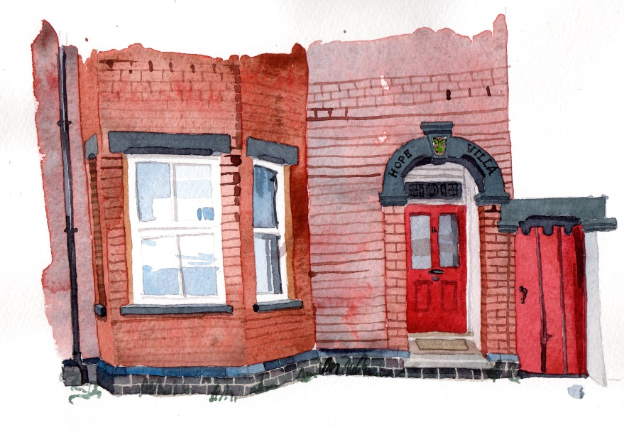
Try this thought-process exercise
  Fieldwork
Answer this question:
“How many windows are there in the place where you normally live?”
Note your thought processes
Image credit: illustration by Wil Freeborn in book “Surveys that work”

Slide 82
Strategies can be in your head, elsewhere, ask
  Fieldwork
Typical strategies are:
Mental walkthrough of the place
Look on the receipt for the recent new windows (!)
Ask someone else (!)
Image credit: illustration by Wil Freeborn in book “Surveys that work”

Slide 83
Cogability testing is a hybrid method
  Fieldwork
Run a usability test in the usual way BUT
Ask the person to think aloud as they work AND
Interrupt them with cognitive probes
  “Tell me about how you thought of that answer”
  “Did you know that answer straight off or think about it?”
  “Was that answer from counting or a guess?”
“Cogability testing” coined by Laura Wilson and Emma Dickinson in
“Respondent Centred Surveys” (2021)

Slide 84
Let’s test a questionnaire
  Fieldwork
Please volunteer!
I have a test participant here ready to try it
Everyone else: you are note-takers

Slide 85
If I can only do one, it’s a pilot study
  Fieldwork
Review with stakeholders
Testing with users
Goals to decisions
Person-led expert review
Pilot study
Usability test
Cognitive test
Cogability test

Slide 86
Takeaway
“It’s done when
a real user has used it
for something real”
- By me

Slide 87
Think about the test and iterate
  Fieldwork
Are the people you tested with representative?
Did you test the whole survey
  From invitation to follow up?
  Including the analysis of responses?
  Including finding out whether you can make the decision?
What do you need to change for the next version?

Slide 88
The questions are linked with the ones who respond
  Fieldwork
Why you want ask
Who you want to ask
The number

Slide 89
Tomorrow we’ll look at responses
  Goals
  Sample
  Questions
  Questionnaire
  Fieldwork
  Responses
  Reports
  Establish your goals for the survey
  Decide who to ask and how many
  Test the questions
  Build the questionnaire
  Run the survey from invitation to follow-up
  Clean and analyse the data
  Present the results
Yesterday
Today
Tomorrow

Slide 90
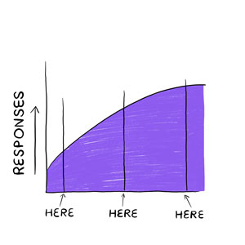
Start analysing when you have any responses

Slide 91
Please join my EasyRetro
You’ll find columns for:
Anything useful from today
Not useful / confusing / could have skipped
Want to know but hasn't yet come up
Has come up but want more

Slide 92

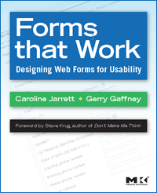

Caroline Jarrett
@cjforms
www.slideshare.net/cjforms
carolinej@effortmark.co.uk

