Slide 1
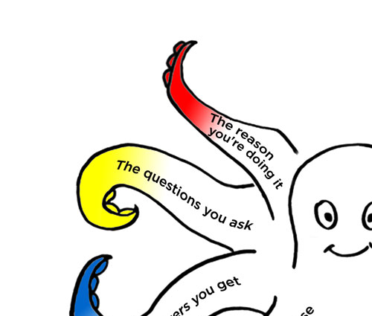
Surveys that work
Session 1 of 3
An introduction to
the Survey Octopus
and Total Survey Error
Caroline Jarrett
@cjforms
#surveysthatwork2022

Slide 2
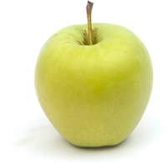


Welcome to three sessions of surveys
I’ll aim to cover all the steps in doing a survey
  Today will focus on why we’re doing the survey and who to ask
  Tomorrow will be mostly about questions and questionnaires
  Wednesday will be about dealing with responses and reporting
You will join in – I hope
  Your experiences, thoughts, comments, and questions
  Some things to try individually, others in groups
We’ll use an example survey
Image credits: Apple by IamCristian on Unsplash Orange by Adam Nieścioruk on Unsplash
Cherry by Quaritsch Photography on Unsplash

Slide 3
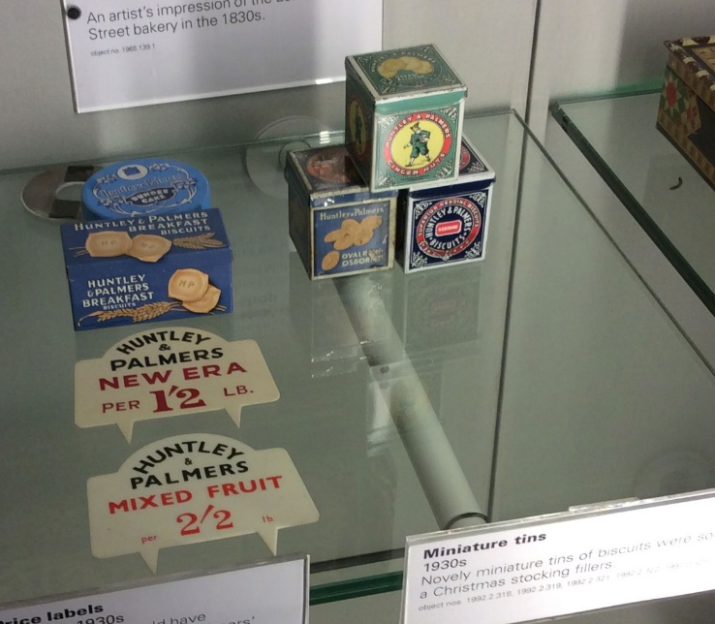
Introductions
(I’m Caroline Jarrett)
I’m going to start
  My name and role
  A random thing about me
Image credit: Caroline Jarrett

Slide 4
Get into your groups for introductions
We have three groups
  You are in Apple, Orange, or Cherry
  Our Rosenfeld Media support person, Elle, is here to help us
Introduce yourselves
  Your name and role
  A random thing about yourself
5 minutes

Slide 5
Let’s find out about our experiences

Slide 6
Keep a note of your answers to these questions
1. How many surveys have you run?
NONE 1 to 5 6 to 10 more than 10
2. What is your top tip for a better survey, based on experience of writing or answering?
__________________________________
__________________________________

Slide 7
Two volunteers, please

Slide 8
Try it as an interview
1. How many surveys have you run?
NONE 1 to 5 6 to 10 more than 10
2. What is your top tip for a better survey, based on experience of writing or answering?
__________________________________
__________________________________

Slide 9
Let’s practice with the retro board
Please share
your number of surveys (none is fine!)
your tips (none yet is fine!)
5 minutes

Slide 10
Overview of surveys and process

Slide 11
I found this survey methodology definition
The survey is a
systematic method
for gathering information from
(a sample of) entities
for the purpose of
constructing quantitative descriptors
of the attributes of the larger population
of which the entities are members.
Groves, Robert M.; Fowler, Floyd J.; Couper, Mick P.; Lepkowski, James M.; Singer, Eleanor & Tourangeau, Roger (2004).Survey methodology. Hoboken, NJ: John Wiley & Sons.

Slide 12
I change the definition a bit
systematic method becomes process
gathering information becomes asking questions
entities become people
quantitative descriptors become numbers about
attributes of the larger population become make decisions

Slide 13
My definition focuses on a survey as a process
The survey is a
process
of asking questions that are answered by (a sample of) a defined group of people
to get numbers
that you can use to make decisions

Slide 14
Let’s rearrange the definition, survey in the middle
To make decisions
People
Why you want ask
Who you want to ask
The survey is a
process for getting answers to questions
The number
getting numbers

Slide 15
The aim of a survey is to get the number that helps you to make a decision
Why you want ask
Who you want to ask
The Survey
The number
Notes:
The survey sits between 'what you want to ask', 'who you want to ask' and 'the number'

Slide 16
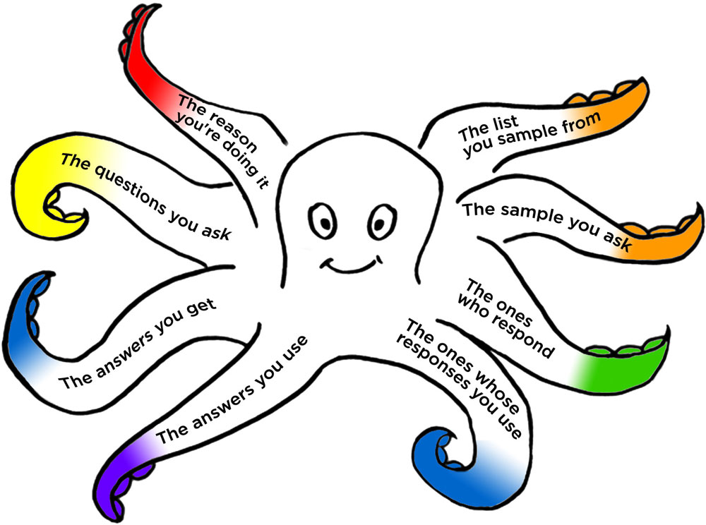
The Survey Octopus has things to think about
Why you want ask
Who you want to ask
The number
Notes:
The survey sits between 'what you want to ask', 'who you want to ask' and 'the number'

Slide 17
There are errors all around the Survey Octopus
Why you want ask
Who you want to ask
Coverage error
(Lack of) validity
Sampling error
Measurement error
Non-response error
Processing error
Adjustment error
The number
Notes:
The octopus again; we've looked at 6 of the 8 tentacles.

Slide 18
There are steps in the process for each area
Goals
Sample
Questions
Questionnaire
Fieldwork
Response
Response
Reports
Notes:
The octopus again; we've looked at 6 of the 8 tentacles.

Slide 19
Here are the 7 steps as a linear process
  Goals
  Sample
  Questions
  Questionnaire
  Fieldwork
  Responses
  Reports
  Establish your goals for the survey
  Decide who to ask and how many
  Test the questions
  Build the questionnaire
  Run the survey from invitation to follow-up
  Clean and analyse the data
  Present the results
  Questions you need answers to
  People you will invite to answer
  Questions people can answer
  Questions people can interact with
  People who actually answer
  Answers
  Decisions

Slide 20
Today we get clear objectives
  Goals
  Sample
  Questions
  Questionnaire
  Fieldwork
  Responses
  Reports
  Establish your goals for the survey
  Decide who to ask and how many
  Test the questions
  Build the questionnaire
  Run the survey from invitation to follow-up
  Clean and analyse the data
  Present the results
Today
Tomorrow
Wednesday

Slide 21
The goals set the scene for the survey
  Goals
  Goals
  Establish your goals for the survey
  Questions you need answers to

Slide 22
Establish your goals for your survey
  Goals
What do you want to know?
Why do you want to know?
What decision will you make based on these answers?
What number do you need to make the decision?

Slide 23
We will try this example
  Goals
“We want to know what users think about
our new funding application process”

Slide 24
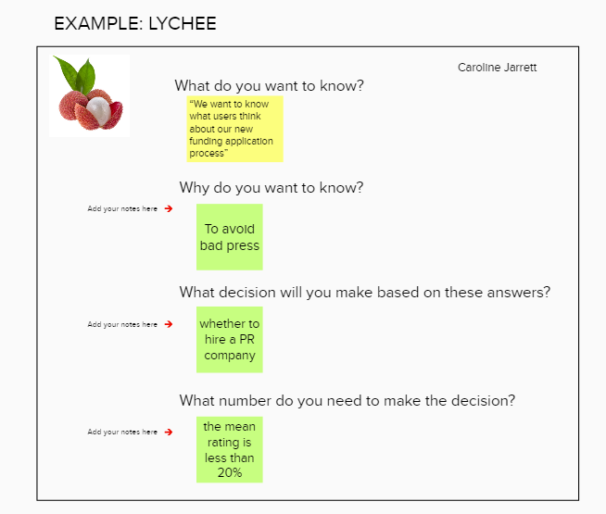
I gave it a go
  Goals

Slide 25
Write an idea about why you might want to know
  Goals
“We want to know what users think about our new funding application process”
Why do you want to know?

Slide 26
Write an idea for a possible decision
  Goals
“We want to know what users think about our new funding application process”
Why do you want to know?
What decision will you make based on these answers?

Slide 27
Write an idea for a number
  Goals
“?” is ok! But do try
“We want to know what users think about our new funding application process”
Why do you want to know?
What decision will you make based on these answers?
What number do you need to make the decision?

Slide 28
Compare your ideas in your groups
  Goals
Join your breakout room
Visit the Mural board
Find the board area for your breakout room
Add your sticky notes
Discuss in the room
5 minutes

Slide 29
How was that for you?
  Goals
Why do you want to know?
What decision will you make based on the answers?
What number do you need make the decision?

Slide 30
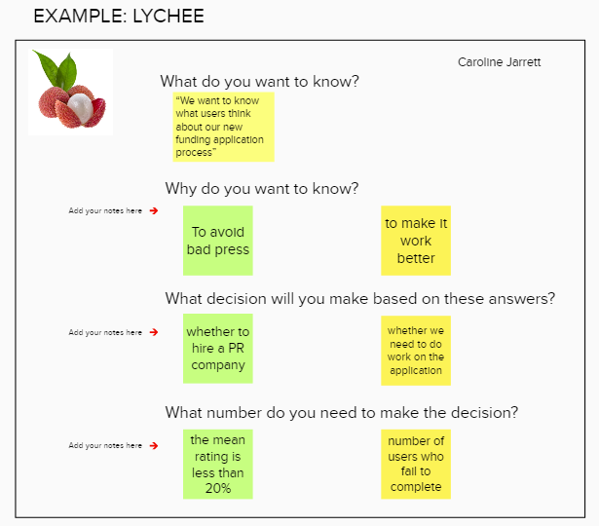
Sometimes the result is a change of ideas
  Goals
Notes:
The board now has some extra stickies:
- to make it work better
- whether we need to do work on the application
- number of users who fail to complete

Slide 31
  Goals
Takeaway
Think carefully about
whether you need a quantitative method

Slide 32
Break

Slide 33

The 1950s mindset was “Ask Everything”
  Goals
Survey =
Big Honkin’ Survey

Slide 34
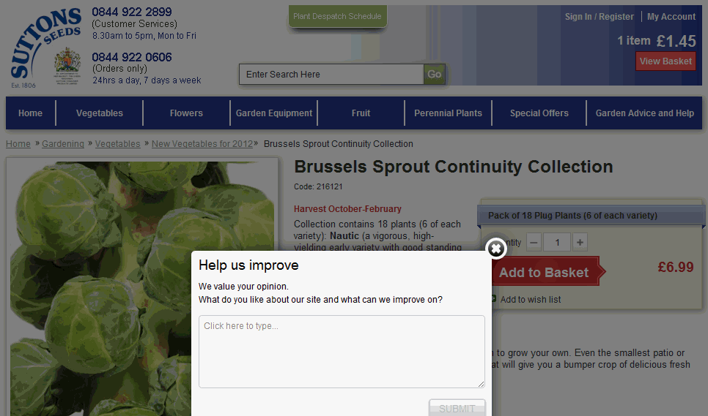
This one-box survey asks one open question
  Goals
Notes:
Screenshot of the Suttons Seeds website with a pop-up box: "Help us improve. We value your opinion. What do you like about our site and what can we improve on?"

Slide 35
Technology allows us to do the Light Touch survey
  Goals
Choose ONE question
Find ONE person
Ask the question, face-to-face
Think about representativeness
See if you can make ONE decision
Improve, iterate, increase

Slide 36
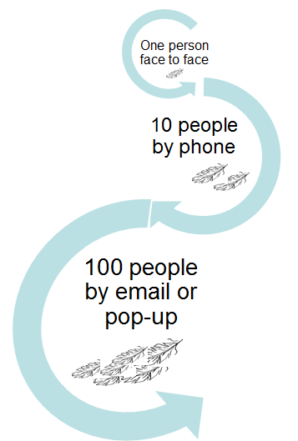
You can get from
1 to 100 in three steps
  Goals
Time for a new question

Slide 37
What’s the Most Crucial Question (MCQ)?
  Goals
The MCQ is the one that stakeholders most want to ask
An MCQ lets you calculate a numeric answer somehow
It’s a research question that may need work
  It may not (yet) make sense to the people who will answer
  That’s part of the fun of creating a survey

Slide 38
What’s the Most Crucial Question?
  Goals
Look through the questions in this survey
What is the Most Crucial Question?
2 minutes

Slide 39
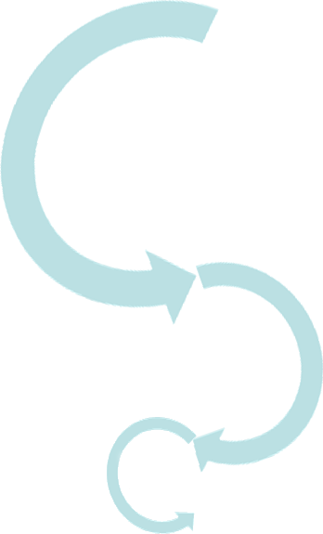
Narrowing down from lots of questions is another way to iterate and improve
  Goals
Lots of questions
Useful questions
MCQ

Slide 40
Here are the 7 steps as a linear process
  Goals
  Sample
  Questions
  Questionnaire
  Fieldwork
  Responses
  Reports
  Establish your goals for the survey
  Decide who to ask and how many
  Test the questions
  Build the questionnaire
  Run the survey from invitation to follow-up
  Clean and analyse the data
  Present the results
  Questions you need answers to
  People you will invite to answer
  Questions people can answer
  Questions people can interact with
  People who actually answer
  Answers
  Decisions

Slide 41
Let’s have a look at who we’ll ask
  Sample
  Sample
  Decide who to ask and how many
  People you will invite to answer

Slide 42
Asking the right people is better than asking lots of people
  Sample
Who you want to ask
Sample
The number
Notes:
The octopus, with focus on 'The list you sample from'

Slide 43
Coverage error happens when ‘who you want to ask’ does not match the list you sample from
  Sample
Who you want to ask
Coverage error

Slide 44
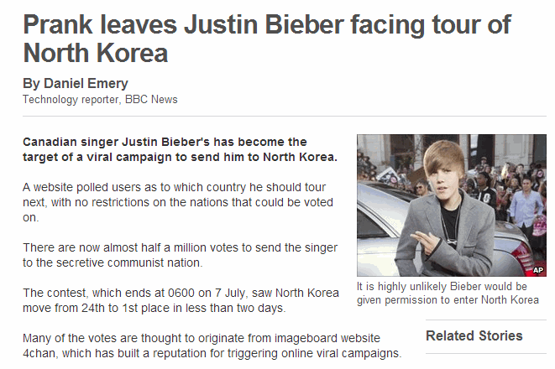
This prank co-ordinated unwanted respondents
  Sample
http://www.bbc.com/news/10506482
Notes:
Prank leaves Justin Bieber facing tour of North Korea
By Daniel Emery Technology reporter, BBC News
5 July 2010
Image caption It is highly unlikely Bieber would be given permission to enter North Korea Canadian singer Justin Bieber's has become the target of a viral campaign to send him to North Korea.
A website polled users as to which country he should tour next, with no restrictions on the nations that could be voted on.
There are now almost half a million votes to send the singer to the secretive communist nation.
The contest, which ends at 0600 on 7 July, saw North Korea move from 24th to 1st place in less than two days.
Many of the votes are thought to originate from imageboard website 4chan, which has built a reputation for triggering online viral campaigns.

Slide 45

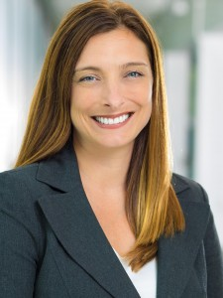
Lopez and Hillygus found that people are naughty
  Sample
“Our results suggest that not only do “survey trolls” exist, and report beliefs in systematically different ways, but their humorous responding can upwardly bias the level of belief in more recent cases of political rumors and misinformation (e.g., PizzaGate).”
Lopez, Jesse and Hillygus, D. Sunshine,
Why So Serious?: Survey Trolls and Misinformation
(March 14, 2018). Available at ttp://dx.doi.org/10.2139/ssrn.3131087
Jesse Lopez
D. Sunshine Hillygus
Image credits: About Me - Jesse Lopez (duke.edu)
D. Sunshine Hillygus | Professor of Political Science and Public Policy (duke.edu)

Slide 46

Response, response rate and representativeness are all different
  Sample
Concept | Definition | Example
Response | Number of answers | 5,000
Response rate | Response divided by the number of invitations | 10%
Representativeness | Whether the respondents you get are typical of the users you want
Image credit: North Korean flag, http://commons.wikimedia.org/wiki/File:Flag_of_North_Korea.svg
Notes:
A classic example of the difference between response and representativeness: a Justin Bieber fan site organised a poll to see where the teen star should have his next concert. The poll got a big response but the winning location was North Korea. It seems unlikely that the respondents were representative of true Bieber fans.

Slide 47

Did we get answers from the right people?
  Sample
The sample we got
Image credit: Caroline Jarrett / CorelDraw

Slide 48
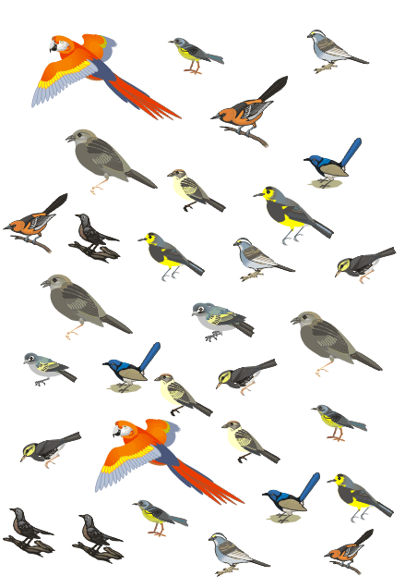
Check the representativeness of your sample
  Sample
Who we wanted to ask
The sample we got
Image credit: Caroline Jarrett / CorelDraw

Slide 49
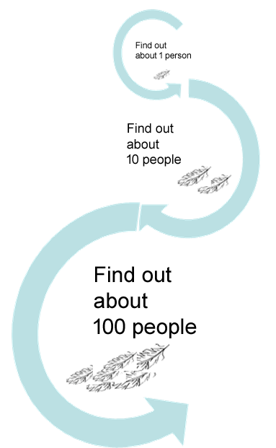
Iterate, improve, increase to understand the people you want to ask
  Sample

Slide 50
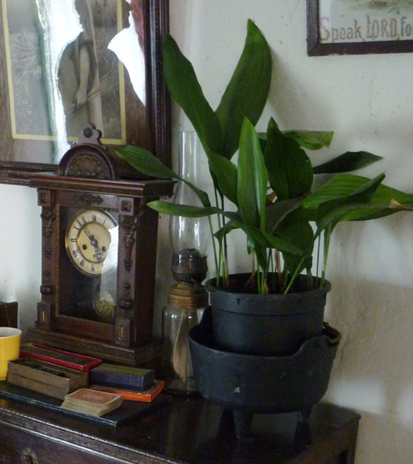
Decide how to target the correct people
  Sample
Iterate down from a list
  Public list
  Private list
Try a ‘snowball’
  Use contacts
  Use social media
Catch them
in the moment
Notes:
The picture reflects the mistakes we can make if we do our sampling based solely on the judgement of an interviewer

Slide 51
Non-response error happens when the people who do not respond are different to the people who do respond in a way that affects your decision

Slide 52
Non-response error can really hurt
  Sample
Non-response error
Notes:
Non-response error:

Slide 53
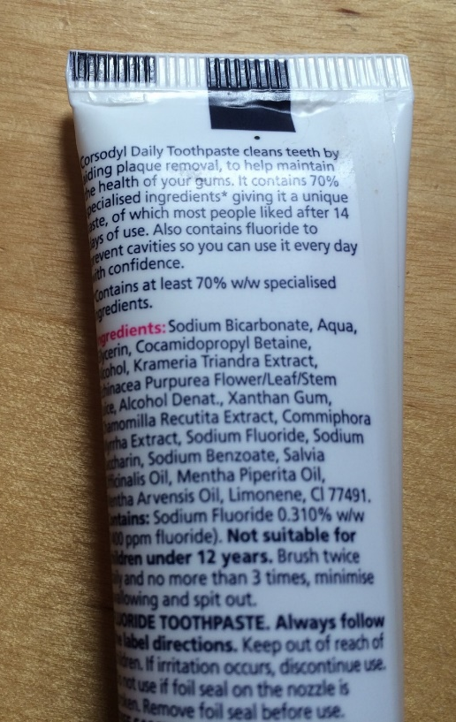
Why might this be non-response error?
  Sample
“… giving it a unique taste of which (sic) most people liked after 14 days of use”
Image credit: Caroline Jarrett

Slide 54

Jane Matthews told me a story
  Sample
  20 people attend a workshop; they all seem to enjoy it
  Only get 3 or 4 back from a web survey
“If we rely on those responses,
we might be at risk of making bad decisions”
Now changing to phoning half the people
Credit: https://janematthews.com/

Slide 55
Who will we ask?
  Sample
“We want to know what users think about
our new funding application process”
Who do we want to ask?
Which strategy will we use to find them? Choose ONE
  Narrow down from a public or private list
  Snowball up from contacts
  Catch them in the moment
Into groups please
5 minutes

Slide 56
How was that for you?
  Sample
Which strategy did you choose for finding your sample?

Slide 57
“The ones who respond” connects to why and who
  Sample
Why you want ask
Who you want to ask
The number
Notes:
The survey sits between 'what you want to ask', 'who you want to ask' and 'the number'

Slide 58
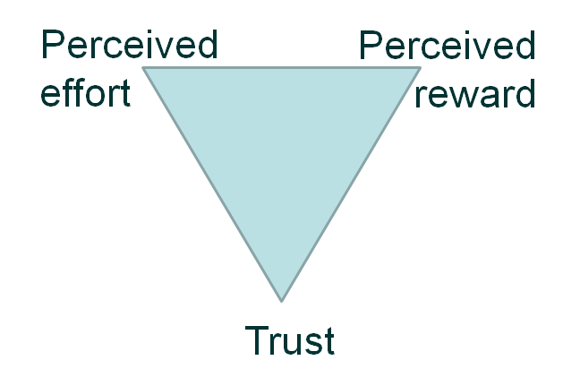
Response depends on effort, reward and trust
  Sample
People will only respond if they trust you. After that, it's a balance between the perceived reward from filling in the survey compared to the perceived effort that's required. Strangely enough, if a reward seems 'too good to be true' that can also reduce the response.
Diagram from Jarrett, C, and Gaffney, G (2008)
“Forms that work: Designing web forms for usability” inspired by Dillman, D.A. (2000)
“Internet, Mail and Mixed Mode Surveys: The Tailored Design Method”
Notes:
People will only respond if they trust you. After that, it's a balance between the perceived reward from filling in the survey compared to the perceived effort that's required. Strangely enough, if a reward seems 'too good to be true' that can also reduce the response.

Slide 59
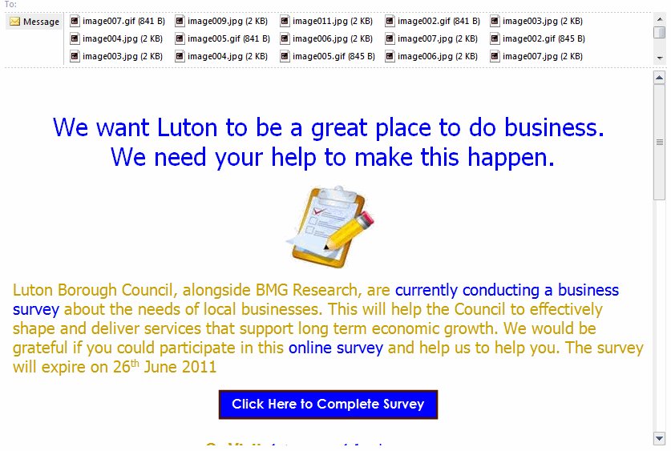
Would you respond to this invitation?
  Sample
Notes:
This is a genuine invitation from local government, but the layout and images in the invitation make it look as if it's an approach from some sort of spammer or scammer.

Slide 60
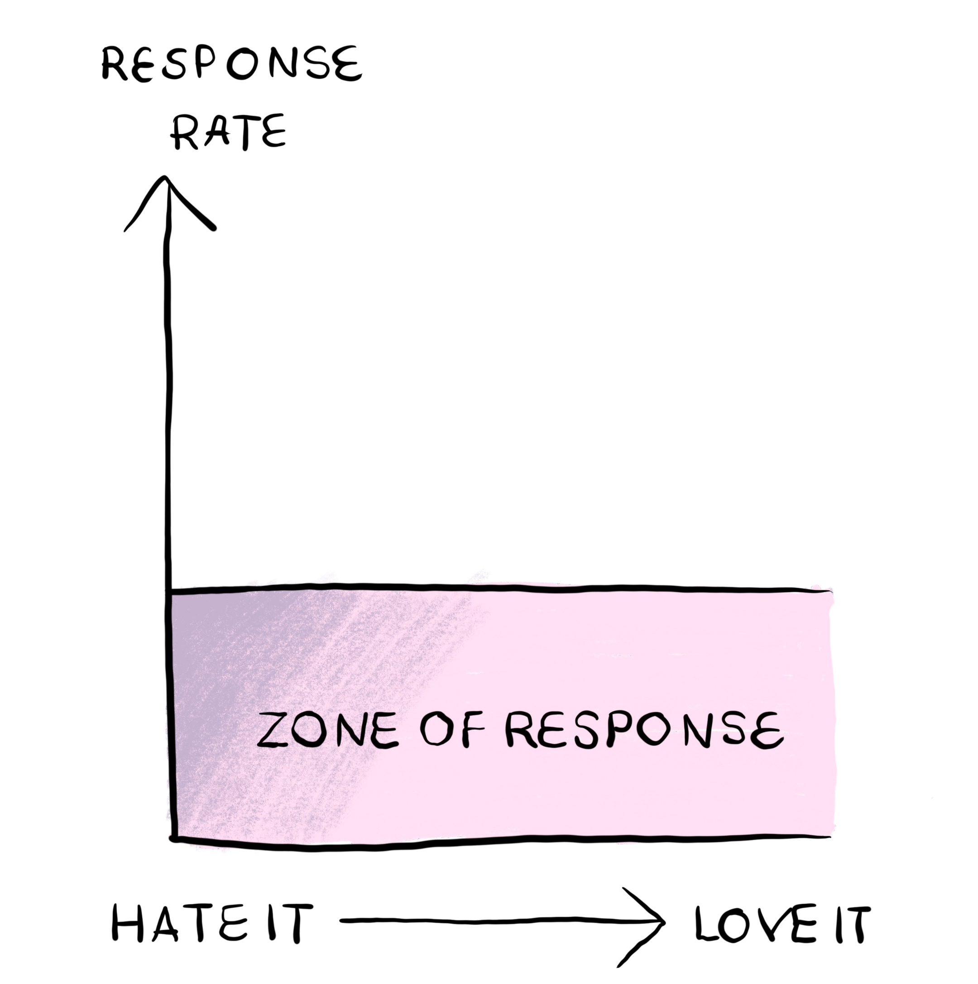
If attitude does not affect response rate, you’d get a graph like this
Image credit: figure 2.5 “Surveys that work: A practical guide for designing and running surveys”

Slide 61
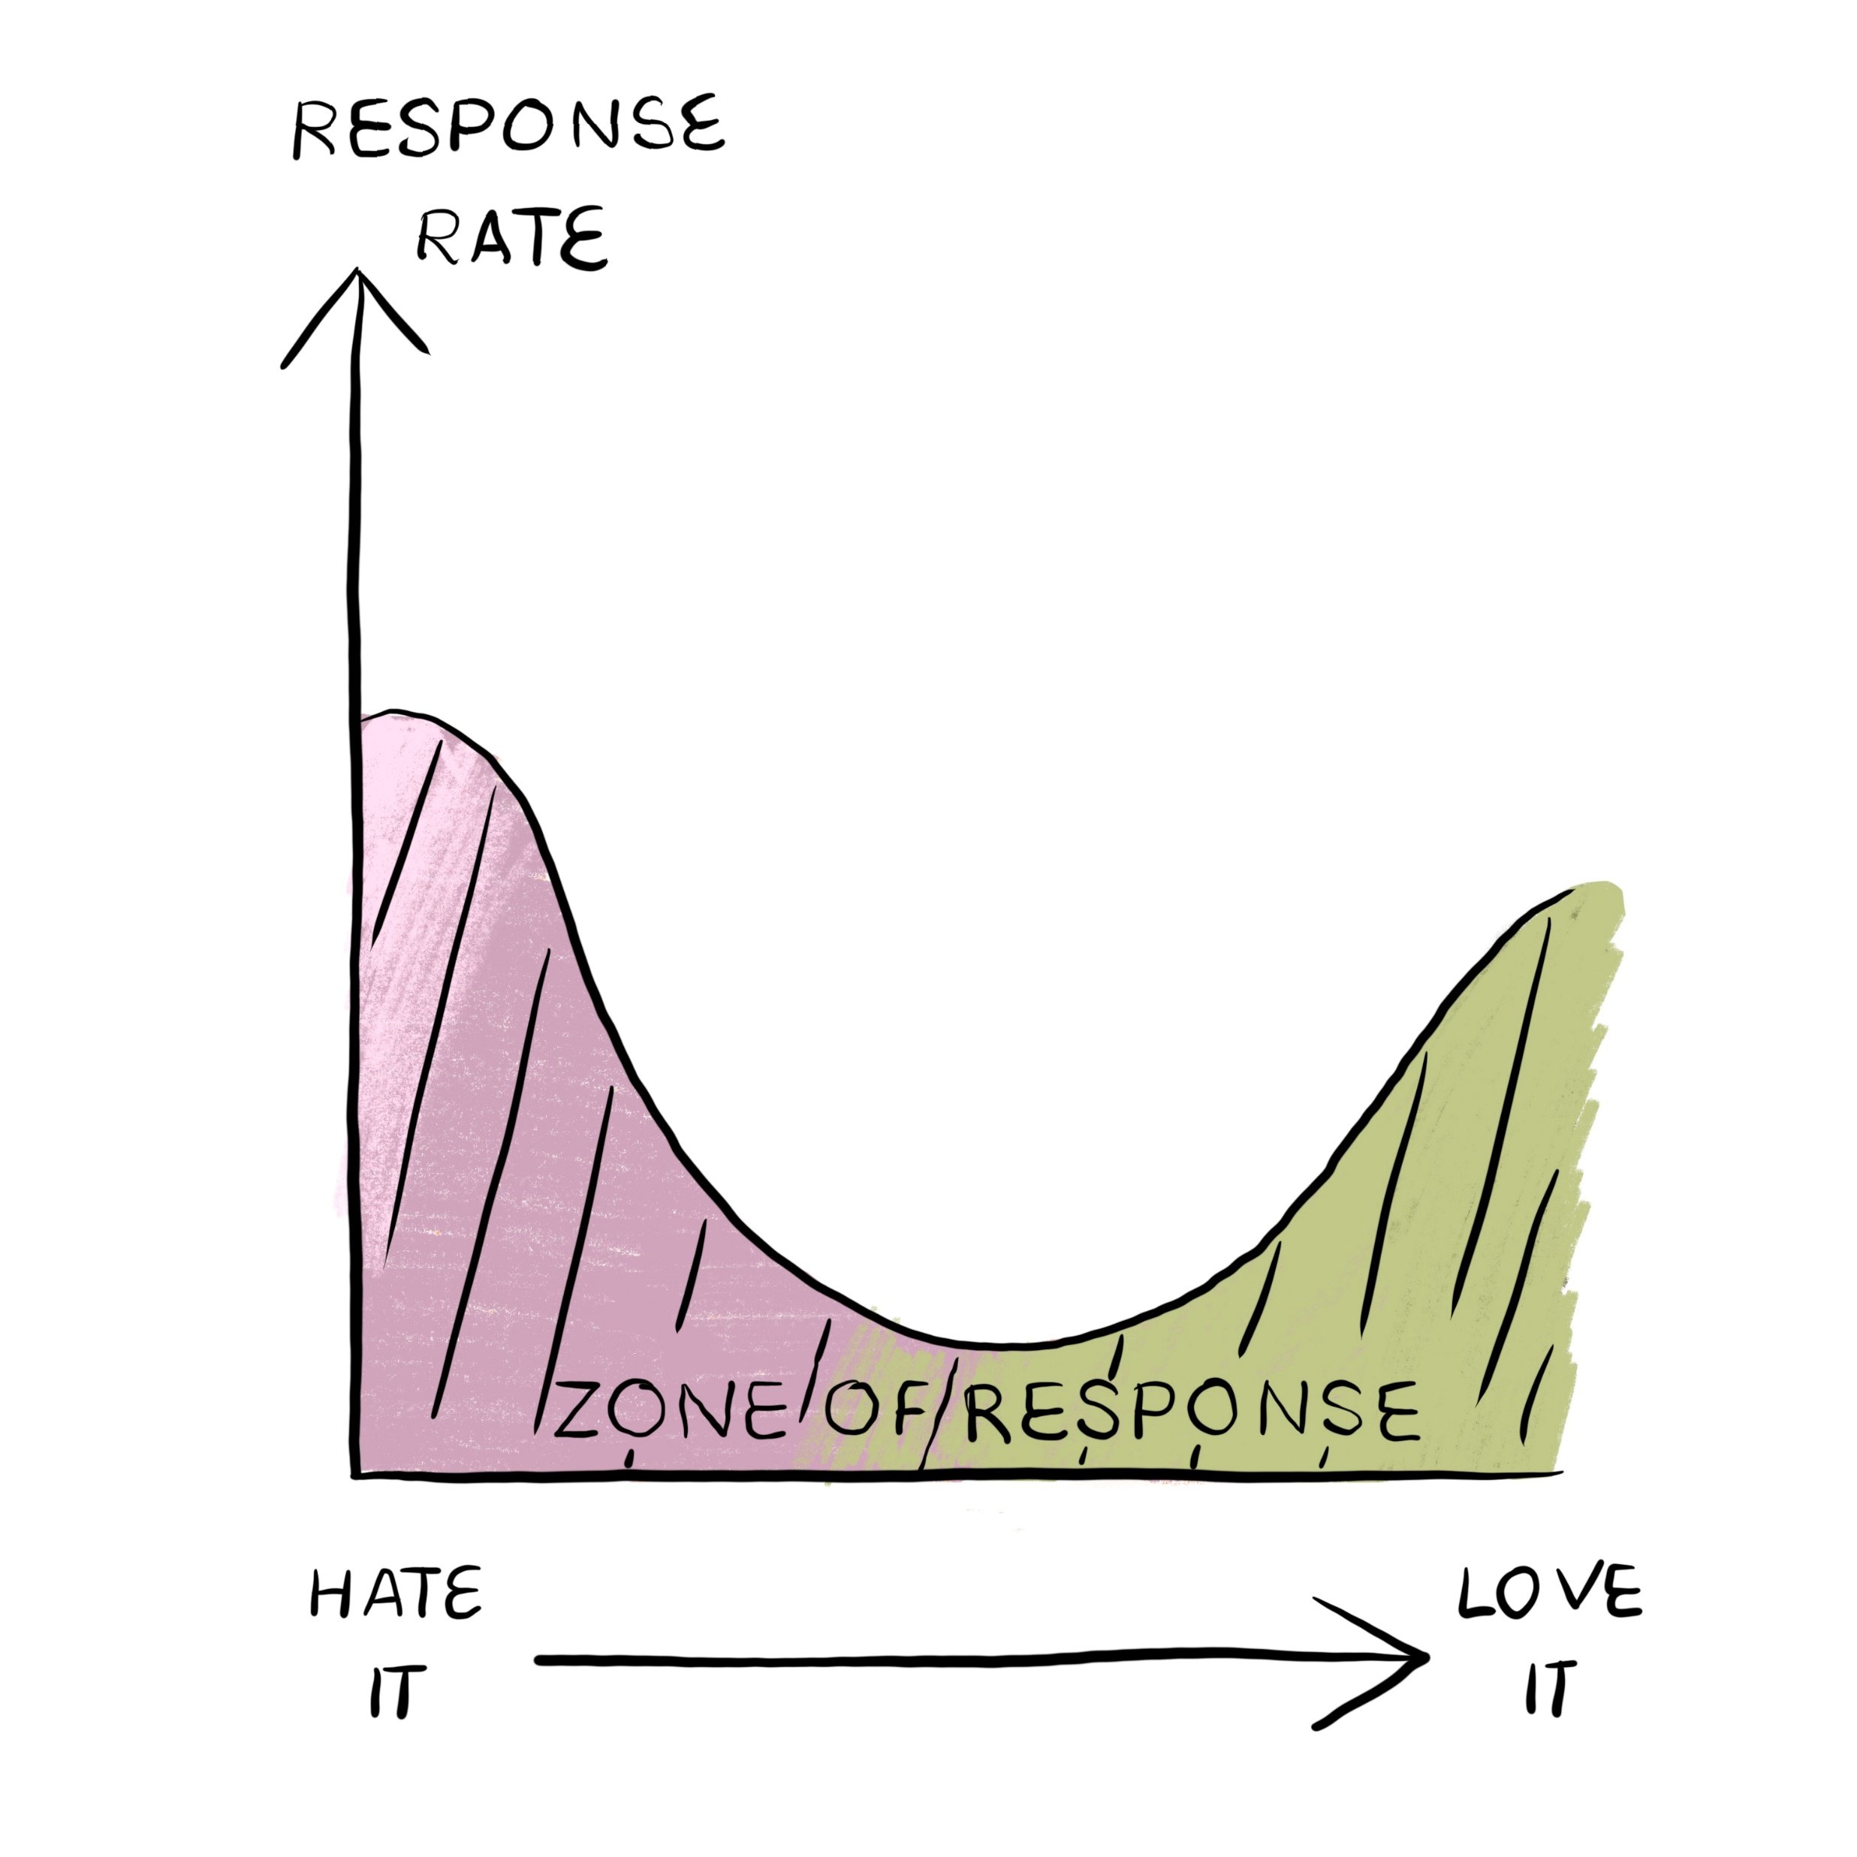
You might get a different picture altogether
  Sample
Image credit: figure 2.6 “Surveys that work: A practical guide for designing and running surveys”

Slide 62
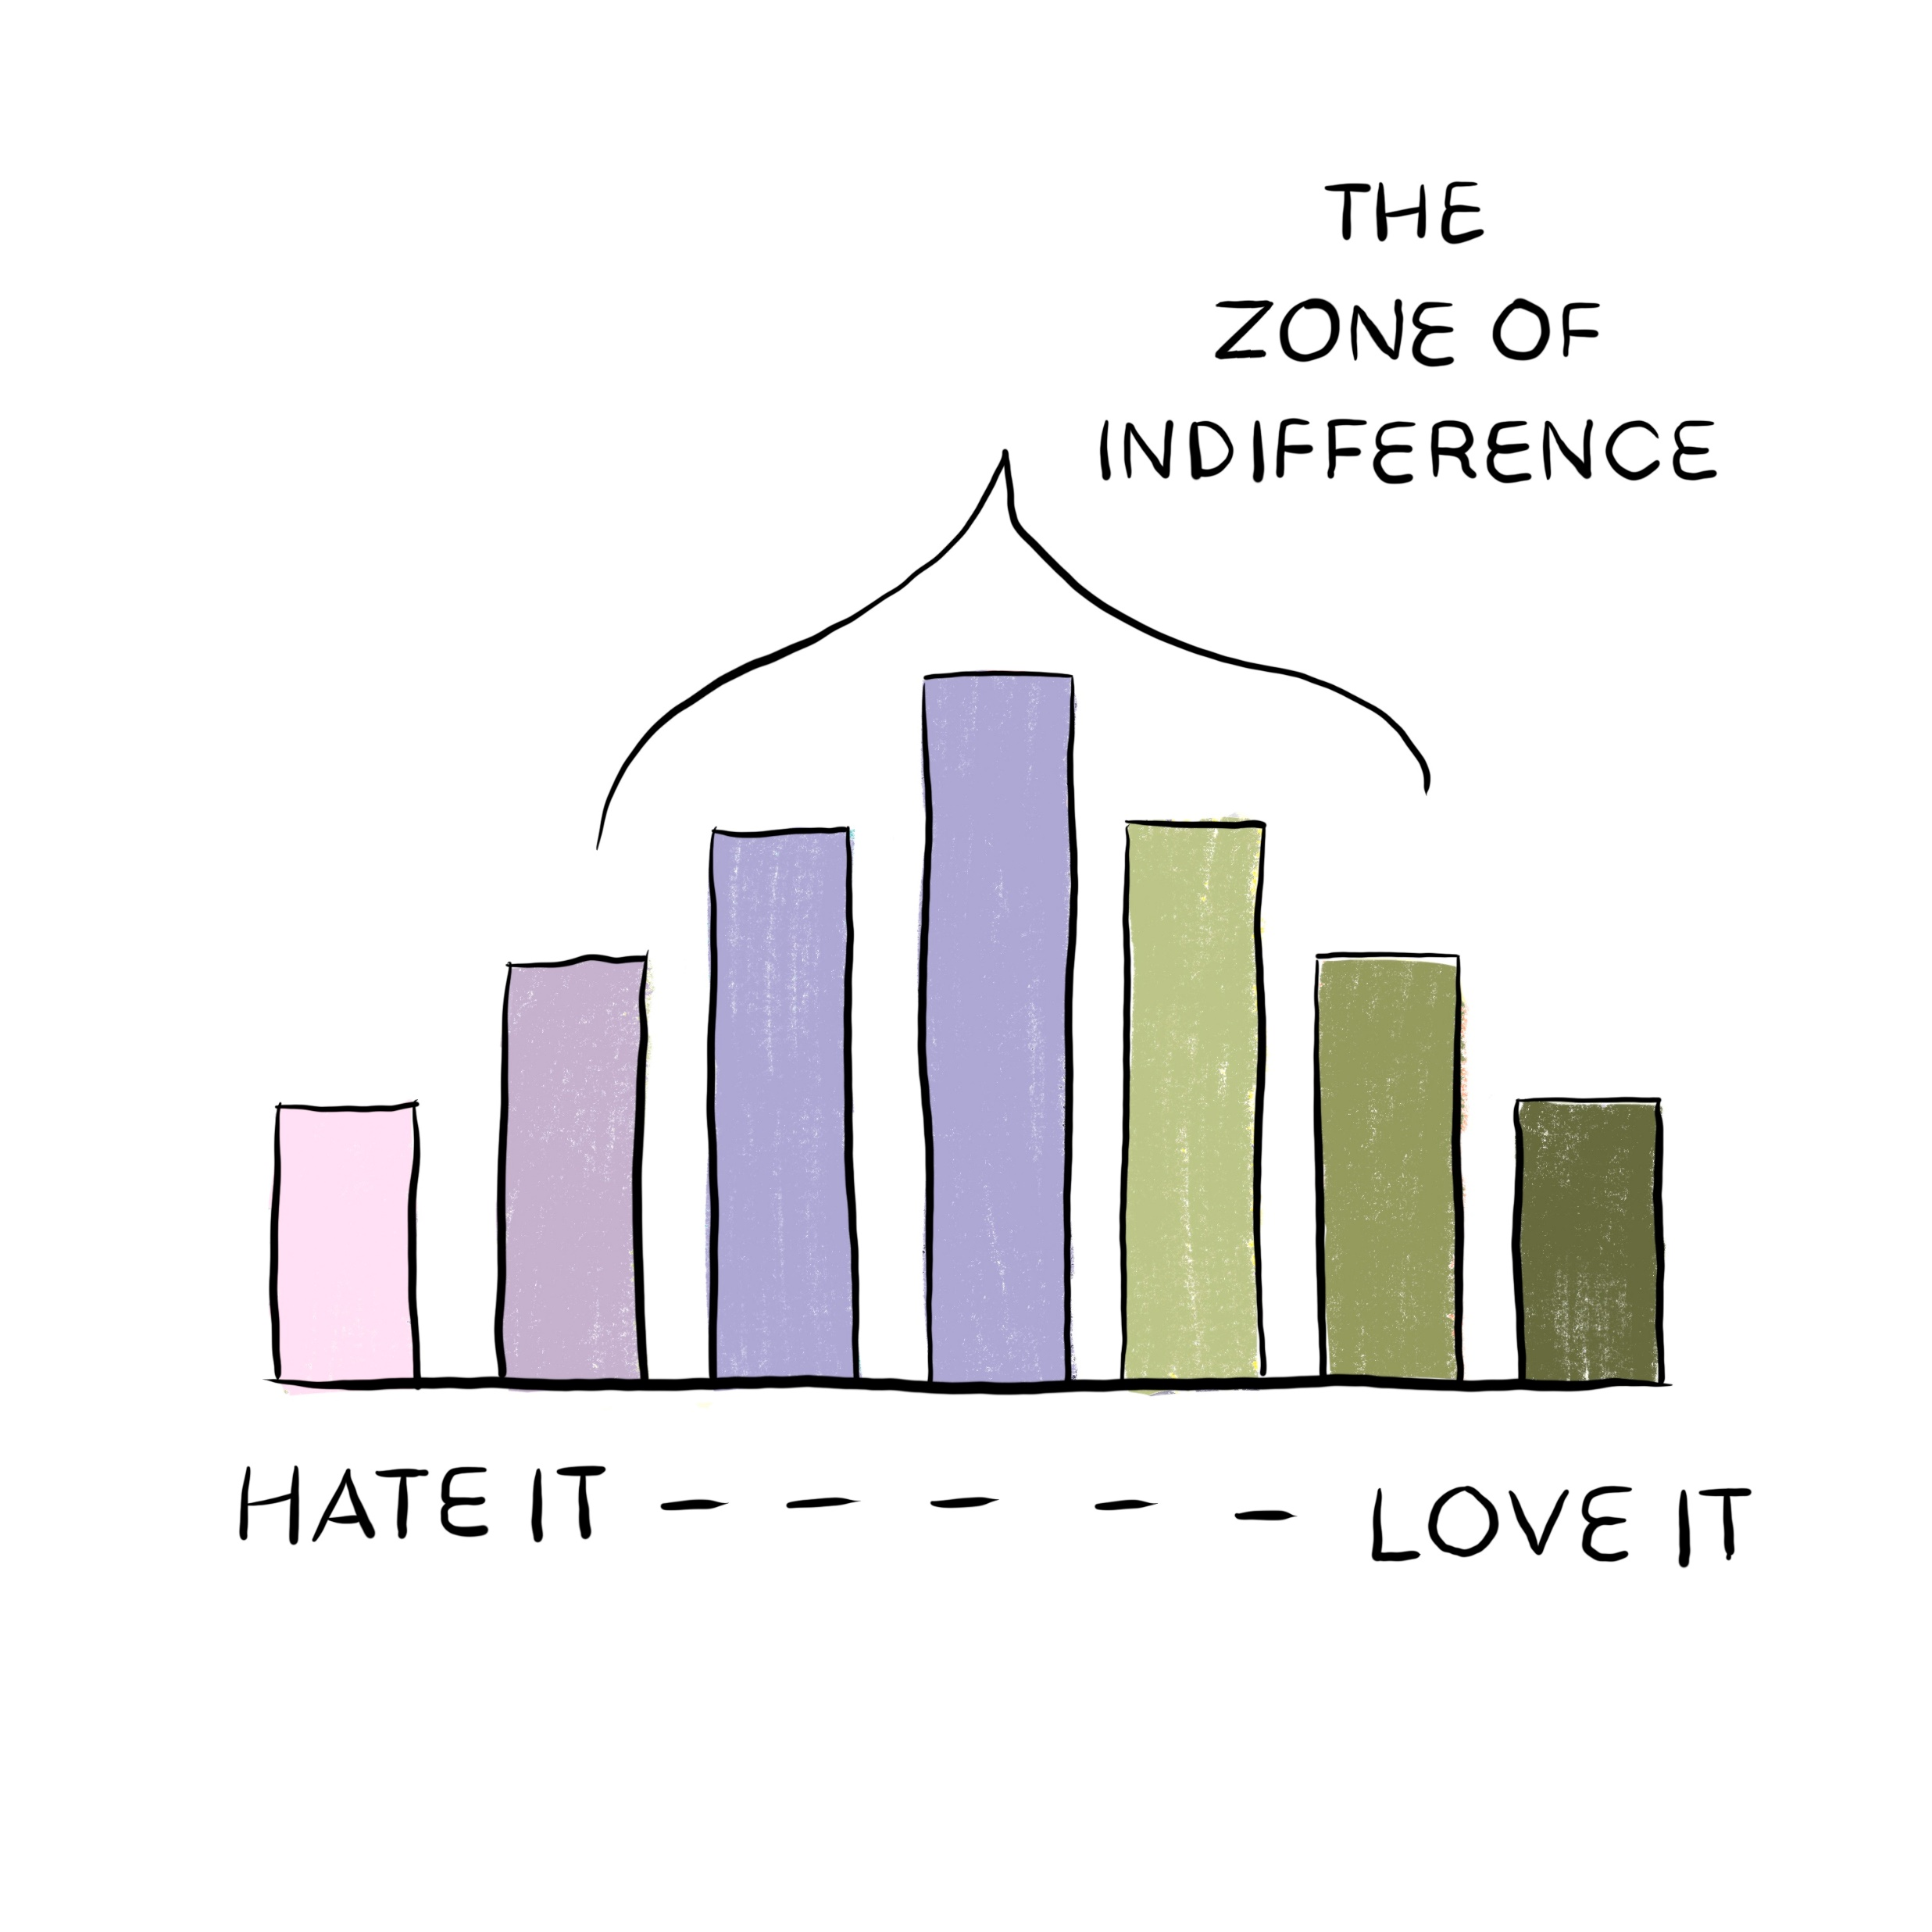
There’s often a
‘zone of indifference’
Image credit: figure 2.7 “Surveys that work: A practical guide for designing and running surveys”

Slide 63
Burning Issues are things people want to tell you
  Sample

Slide 64
What are the Burning Issues?
  Sample
Think about a service that you’ve used recently
Make a note of any Burning Issue that you had

Slide 65
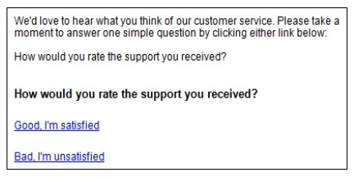
Now answer this questionnaire
  Sample

Slide 66
Did you find space for your issue?
  Sample

Slide 67

Interview users about the topics in your survey
  Sample
Who are they?
How will you find them?
Do they want to answer your questions?
What are their Burning Issues?
Do they understand your questions?
Image credit: design by Julia Allum, words by Caroline Jarrett

Slide 68
Break
  Sample

Slide 69
I often hear plans to “start with a survey”
Observe
Usability test
Analytics
Field study
A/B test
WRONG
Ask
Interview
Survey
Why?
qualitative
How many?
quantitative

Slide 70
It’s much, much better to interview first*
  Sample
Observe
Usability test
Analytics
Field study
A/B test
Ask
Interview
Survey
*It’s also good to do more interviewing later. Iteration is great.
Why?
qualitative
How many?
quantitative

Slide 71
Survey methodologists do lots of testing
  Sample
Usability test
Observe
Analytics
A/B test
Pilot study
Ask
Interview
Survey
Why?
qualitative
How many?
quantitative

Slide 72
Sampling error happens when you ask a sample
  Sample
Sampling error

Slide 73
Sample size calculations need lots of estimates
  Sample
Acceptable level of [statistical] significance (risk of reporting a result when the differences happened by chance, type 1 error)
Power of the study (risk of missing a result that is really there, type 2 error)
Expected effect size (whatever counts as a worthwhile change)
Underlying event rate in the population (how many people affected)
Standard deviation in the population (amount of variability in the population)
Assumptions about sampling
Kadam, P., & Bhalerao, S. (2010). Sample size calculation.
International journal of Ayurveda research, 1(1), 55–57.
Sample size calculation (nih.gov)

Slide 74
What type of significance do you need?
  Sample
A result that is statistically significant is one that is mathematically unlikely to be the result of chance
A result that is significant in practice is one that is
meaningful in the real world

Slide 75
If you ask the wrong questions, you’ll fail at validity
  Sample
Why you want ask
Who you want to ask
(Lack of) validity
Sampling error
The number
Notes:
The octopus again; we've looked at 6 of the 8 tentacles.

Slide 76
  Sample
Takeaway
Asking one person
the right question
gets better results
than asking 10,000 people
the wrong question

Slide 77
Significance in practice relates to Total Survey Error
  Sample
Why you want ask
Who you want to ask
Coverage error
(Lack of) validity
Sampling error
Measurement error
Non-response error
Processing error
Adjustment error
The number
Notes:
The octopus again; we've looked at 6 of the 8 tentacles.

Slide 78
  Sample
Takeaway
Statistical significance is completely different from significance in practice

Slide 79
You need these things to calculate a sample size
  Sample
Mostly, we accept these two numbers
  Acceptable level of significance: 05%
  Power of the study: 80%
We have to estimate or decide on these three numbers
  Expected effect size
  Underlying event rate in the population
  Standard deviation in the population
We have to commit to a random sample (every person in the population has a known, non-zero, chance of being selected)

Slide 80
Bacon does increase your risk of cancer
  Sample
A rasher of bacon a day 'ups cancer risk' - BBC News
In the scientific paper
  Sample 1: “a short food-based questionnaire” (n = 475 581)
  Sample 2: “an online 24-hour dietary assessment” (n = 175 402)
  2609 cases of colorectal cancer occurred (0.55%)
    Out of every 1000 people, about 5 and a half got colorectal cancer
  Reporting three times as much red and processed meat every day led to 20% increased risk of cancer
    Out of every 1000 keen “bacon” eaters, about 6 and a half got colorectal cancer
    76g compared to 21g or 2.7oz compared to 0.7oz or 3 rashers compared to 1.
Diet and colorectal cancer in UK Biobank: a prospective study | International Journal of Epidemiology | Oxford Academic (oup.com)

Slide 81
Let’s think about an effect size in surveys
  Sample
A total of [x] individuals were randomly assigned to one of three conditions in a mailed paper questionnaire where demographic questions were
  not asked,
  integrated at the end of the survey, or
  included as standalone questions on a separate piece of paper
We’re looking at changes in response rate
  “1 - not asked” means we may lose valuable data
  “3 - included as standalone questions” means extra hassle
  We’d prefer to stick to 2 but not if it has a much worse response rate

Slide 82
What effect size would you like to see?
  Sample
We are looking for a change in the expected 33% response rate
What difference in response rate (effect size) are we hoping to detect here?
  A total of [x] individuals were randomly assigned to one of three conditions in a mailed paper questionnaire where demographic questions were
    not asked,
    integrated at the end of the survey, or
    included as standalone questions on a separate piece of paper

Slide 83
Our preferred method has about the same response rate
  Sample
Demographic questions | Response rate
1. not asked | 34.2%
2. integrated at the end of the survey | 33.1%
3. included as standalone questions on a separate piece of paper | 33.0%
Statistically significant? | No
Significant in practice? | Yes
Ziegenfuss, J. Y., et al. (2021). "Impact of demographic survey questions on response rate and measurement: A randomized experiment." Survey Practice 14(1): 26126.

Slide 84
The extra hassle of standalone is not needed
  Sample
Demographic questions | Response rate | Response to demographic questions
1. not asked | 34.2% | (not relevant)
2. integrated at the end of the survey | 33.1% | 32.7%
3. included as standalone questions on a separate piece of paper | 33.0% | 28.3%
Statistically significant? | No | Yes
Significant in practice? | Yes | Yes
Ziegenfuss, J. Y., et al. (2021). "Impact of demographic survey questions on response rate and measurement: A randomized experiment." Survey Practice 14(1): 26126.

Slide 85
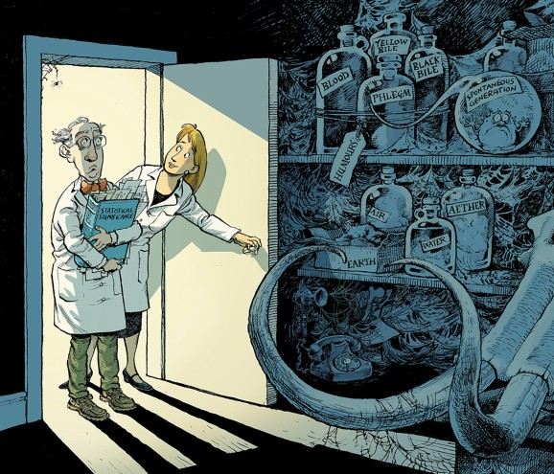
Many statisticians aren’t keen, either
  Sample
Scientists rise up against statistical significance
https://www.nature.com/articles/d41586-019-00857-9

Slide 86
Wrapping up today

Slide 87
Tomorrow we mostly look at questions
  Goals
  Sample
  Questions
  Questionnaire
  Fieldwork
  Responses
  Reports
  Establish your goals for the survey
  Decide who to ask and how many
  Test the questions
  Build the questionnaire
  Run the survey from invitation to follow-up
  Clean and analyse the data
  Present the results
Today
Tomorrow
Wednesday

Slide 88
Please join my EasyRetro
You’ll find columns for:
Anything useful from today
Not useful / confusing / could have skipped
Want to know but hasn't yet come up
Has come up but want more

Slide 89

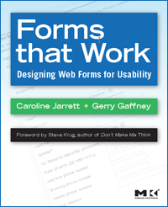

Caroline Jarrett
@cjforms
https://www.effortmark.co.uk
carolinej@effortmark.co.uk

