Slide 1
Forms
studio
Caroline Jarrett @cjforms

Slide 2
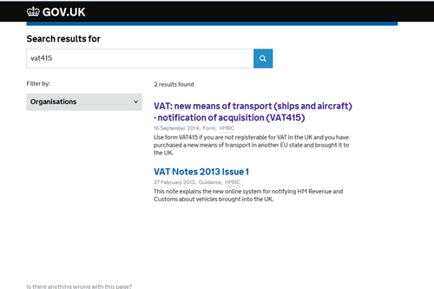
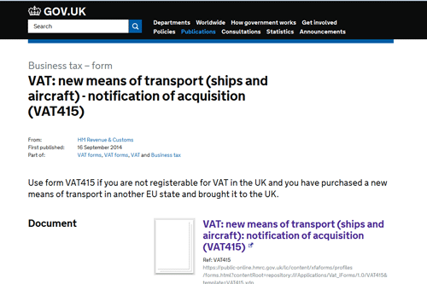
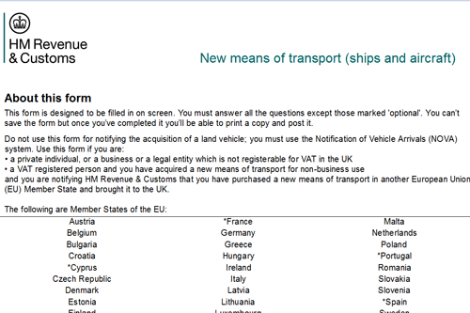
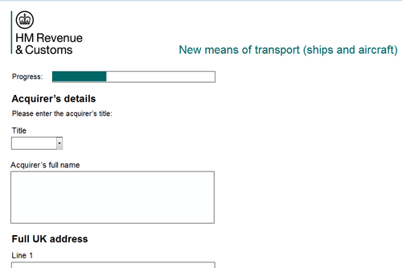
It’s easy to say
which page is the form

Slide 3
It’s a form if it …
Looks like a form and works like a form
Asks questions and expects answers
“transaction”
“service”
Allows
someone to
achieve a
goal

Slide 4
Looks like a form and works like a form
Interaction
Design
Asks questions and expects answers
Content
Strategy
and
Plain
Language
Allows
someone to
achieve a
goal
Service
Design
and
Process
Design

Slide 5
Looks like a form and works like a form
Where you
put the pixels
The questions
you ask
Asks questions and expects answers
Allows
someone to
achieve a
goal
Users’
goals
(and business ones)
The answers
you need

Slide 6
A great form works well across all three layers
Appearance
Lovely and legible.
Simple interaction
Goals achieved
Conversation
Easy to understand
and answer
Goals achieved
Relationship
Goals achieved
Schema from “Forms that work: Designing web forms for usability”, Jarrett and Gaffney (2008) www.formsthatwork.com

Slide 7
How to look at a form

Slide 8
Step 1
Don’t look at it
yet

Slide 9
Step 2
Choose a persona
Write the story of why that
persona is filling in the form

Slide 10
Step 3
Fill in the form
as that persona,
as honestly as you can

Slide 11
Step 4
Now look at it
How did it work across
the three layers?
Appearance
Conversation
Relationship

Slide 12
How to look at a form
Don’t look at it.
Choose a persona and write the story of
why that persona is filling in this form.
Fill in the form as that persona,
as honestly as you can.
Now look at it.
How did it work across the three layers?
    Appearance
    Conversation
    Relationship

Slide 13
Some resources for forms design
For design patterns and GOV.UK elements, search for:
“service manual design patterns”
Or go to
https://designpatterns.hackpad.com
“Forms that work”: http://www.formsthatwork.com
My blog: http://www.effortmark.co.uk/blog

Slide 14




More slides http://www.slideshare.net/cjforms

Slide 15

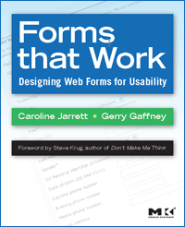

Caroline Jarrett
twitter @cjforms
caroline.jarrett@effortmark.co.uk
www.effortmark.co.uk

